Slide 1
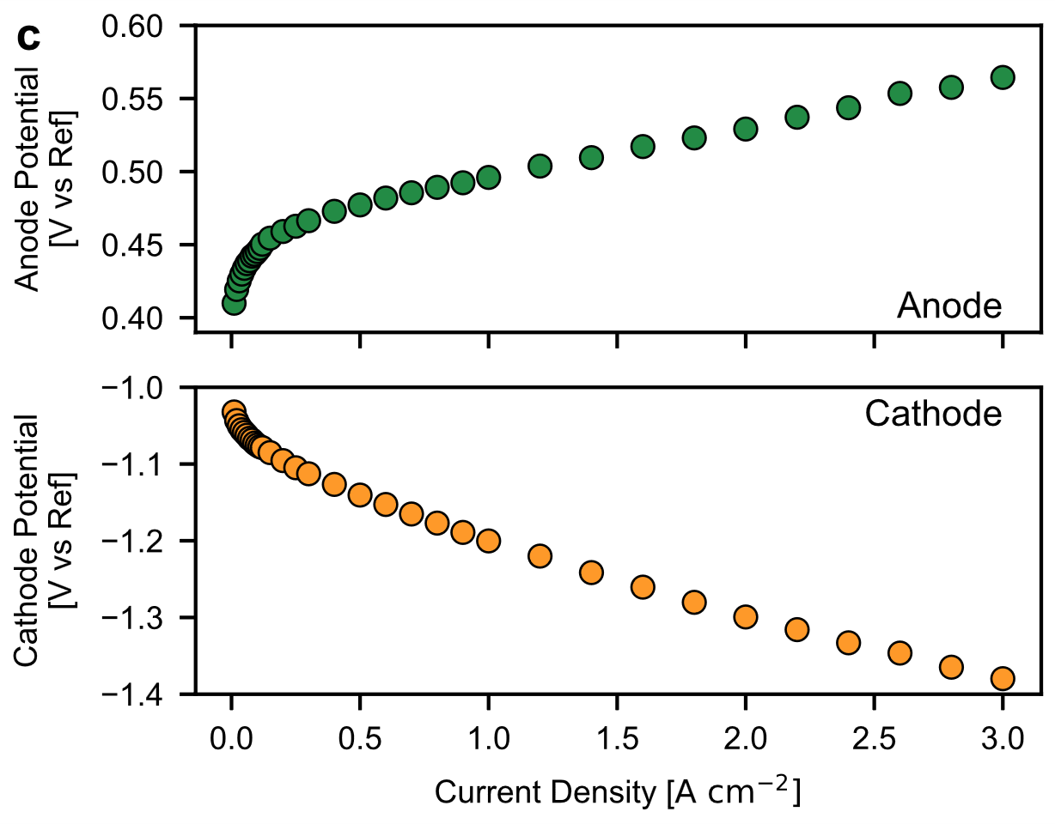
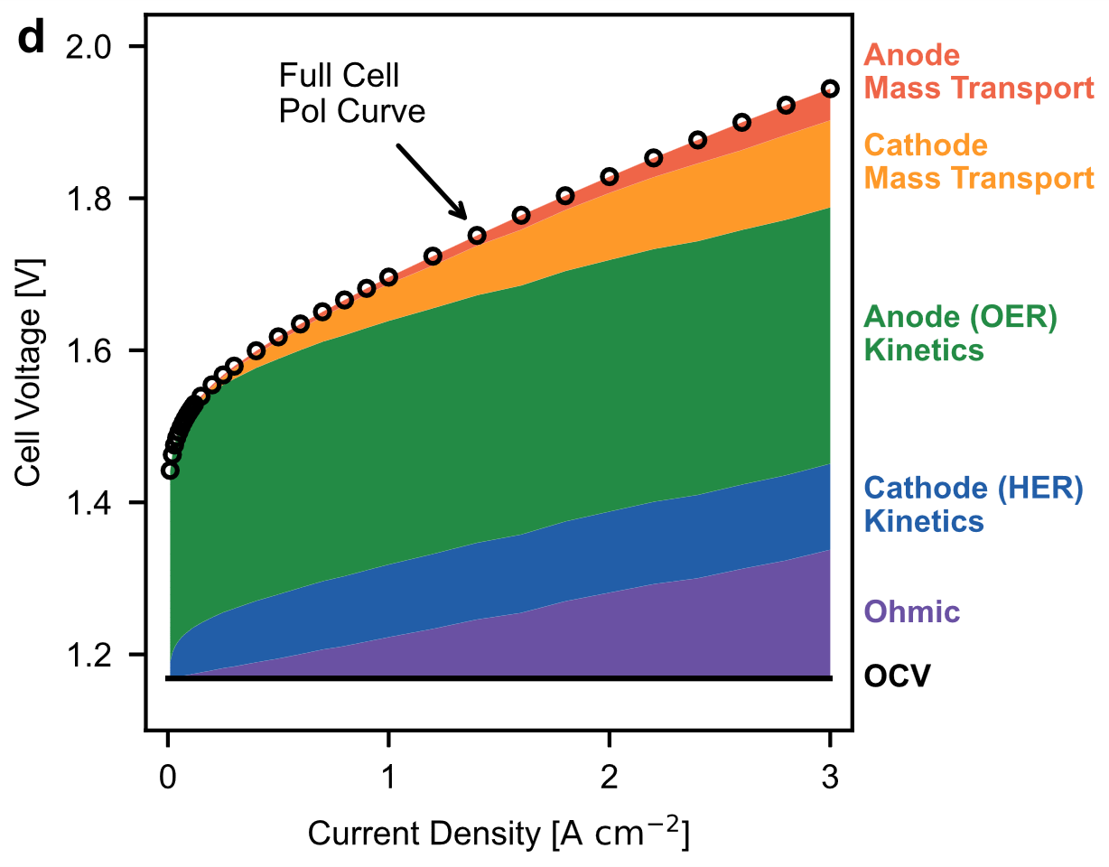
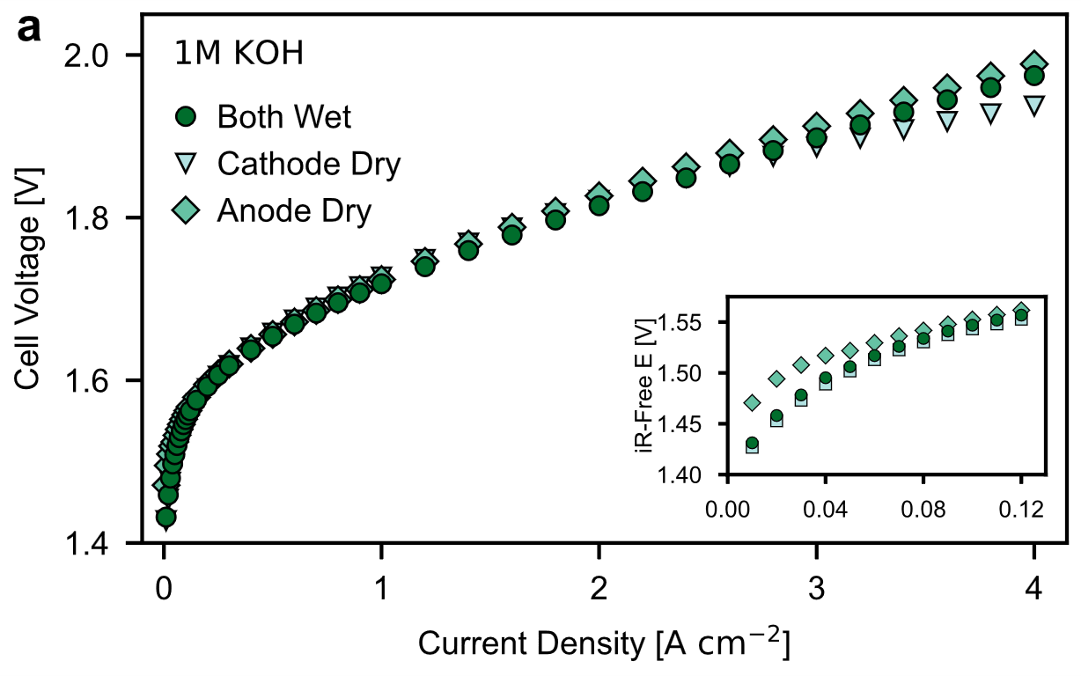
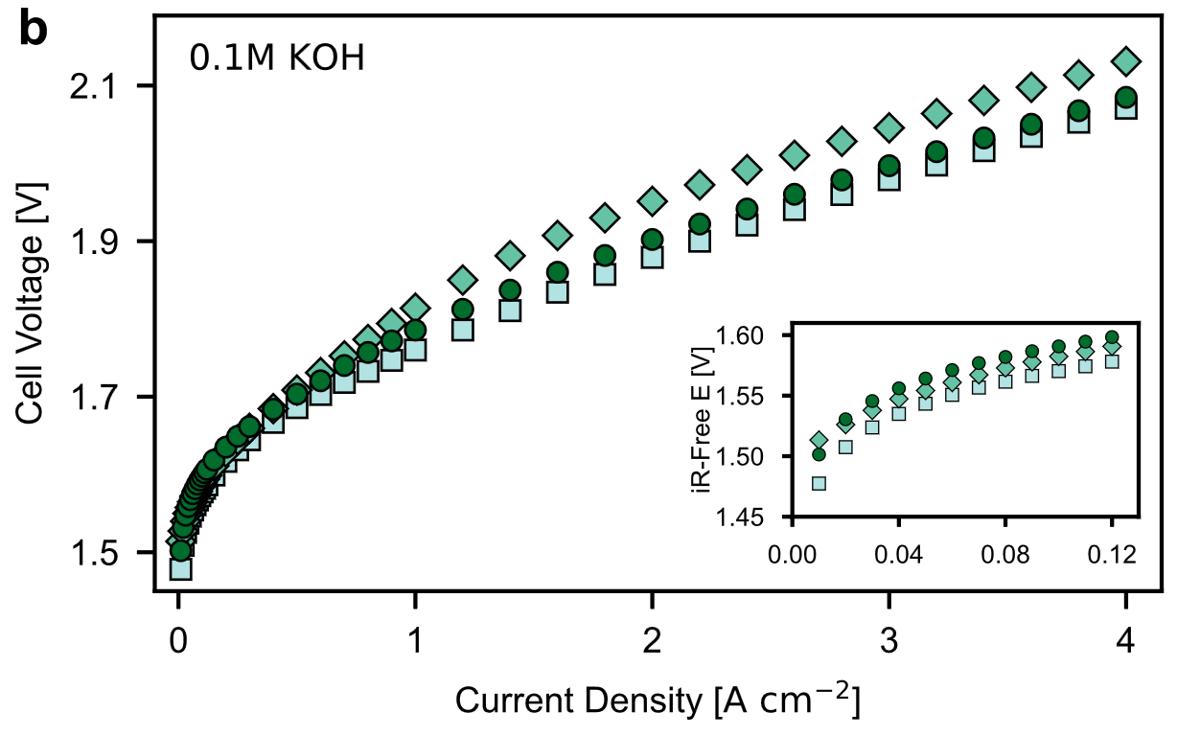
Design and Operating Principles for High-Performing Anion Exchange Membrane Water Electrolyzers
Scientific Achievement:
The component designs and operation conditions of anion exchange membrane water electrolyzers (AEMWEs) are systematically studied to further improve cell performance and durability
Significance and Impact:
This work provides key guidance for the design of electrodes and feed operating conditions for AEMWEs
Research Details:
Custom three electrode MEA is used to identify dominant voltage losses on each electrode of an AEMWE
The importance of water back-diffusion is highlighted, and influence of feed conditions on cell performance is investigated
High performing PGM-free AEMWE exhibited stable performance for over 500 h
Three electrode MEA measures anode and cathode polarization during the AEMWE operation, allowing for cell voltage breakdown
Variation of feed configuration shows that cathode-dry operation can improve AEMWE cell performance
A. W. Tricker, J. K. Lee, J. R. Shin, N. Danilovic, A. Z. Weber, X. Peng, J. Power Sources 2023, 567, 232967

