Slide 1
Integrated Resilient Distribution Planning & Grid Modernization
Paul De Martini
Newport Consulting
Training Webinars on Electricity System Planning
for New England Conference of Public Utilities Commissioners
May 19, 2022
This presentation was funded by the U.S. Department of Energy’s
Grid Modernization Laboratory Consortium.

Slide 2
Planning for the Next 10+ Years
Distribution systems are becoming exceedingly complex, compounded by climate change impacts
 | Yesterday | Today | Tomorrow
Power Flow | One-way flow | Inadvertent 2-way | Scheduled reverse flow
Distributed Solar+Storage | Load modifying resource | Grid services | Grid resource capacity & energy
Electrification | Load growth | Managed load | Grid storage & home resilience
Microgrids | Customer BTM back-up generation | Customer BTM microgrids | Community microgrids & minigrids
Grid Edge | Customer meter | BTM DER | BTM DER & Building Technologies
Ecosystem | ISO, LSE, DistCo & Customer | ISO, LSE, DistCo, Aggregator, DER Service Provider, Community & Customer | ISO, LSE, DistCo, Aggregator, DER Service Provider, MG Operator, EV Charging/Vehicle Mfg, Bldg Automation provider, Community & Customer
Climate & Weather | Predicable patterns of weather and related effects on generation and energy consumption | Uncertainty given increasing storm severity, weather variability trending warmer | Increasing climate and related weather severity and variability incl. warming, droughts, sea rise, etc.

Slide 3
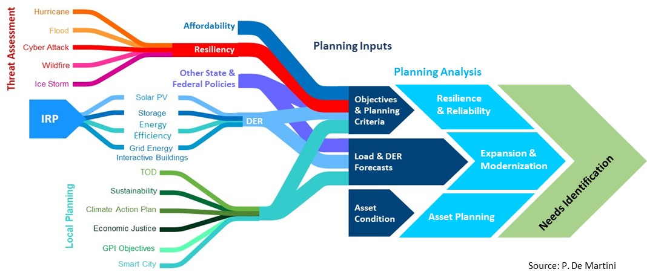
Integrated Distribution Planning Inputs
System planning is increasingly dependent upon Integrated Resource Planning (IRP)/bulk power use of distributed energy resources (DER) and local sustainability and resilience plans.

Slide 4
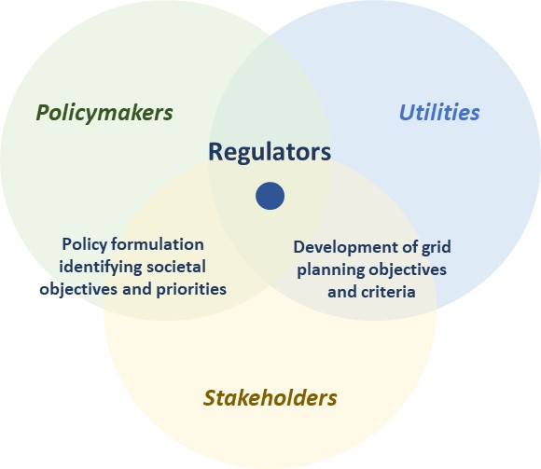
Need for Shared Understanding
Creating a shared understanding among stakeholders of strategies for grid transformation needed to meet resilience, decarbonization, and equity objectives

Slide 5
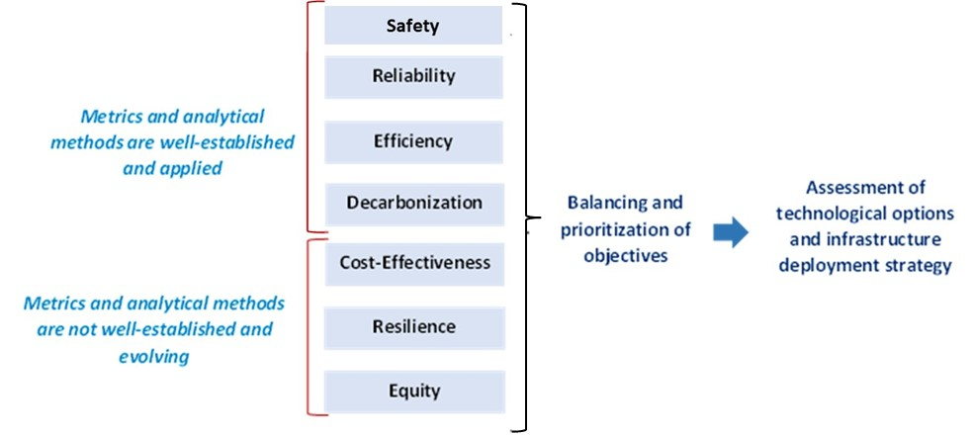
Planning Objectives
A well-designed integrated distribution system planning process provides a framework for translating policy objectives into holistic infrastructure investment strategies.

Slide 6
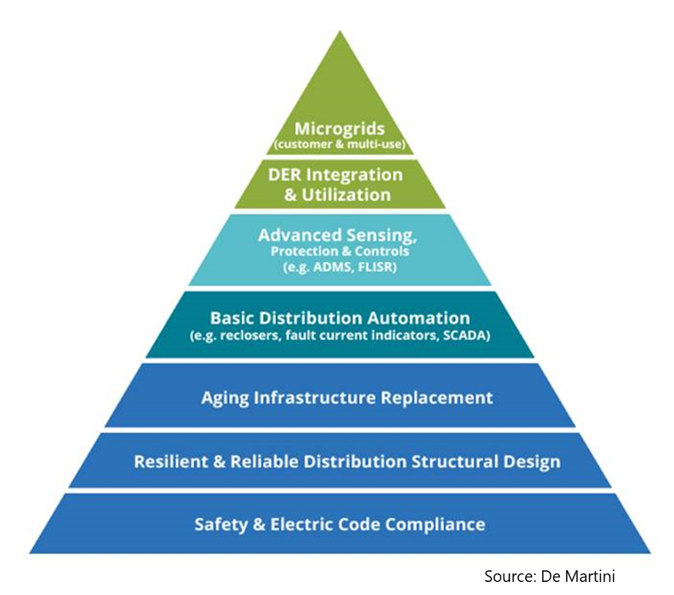
Distribution and Modernization Investment Categories
Grid modernization technologies layer on top of and integrate with foundational physical grid infrastructure.
Grid Modernization
Reliability & Resilience
Asset Planning

Slide 7
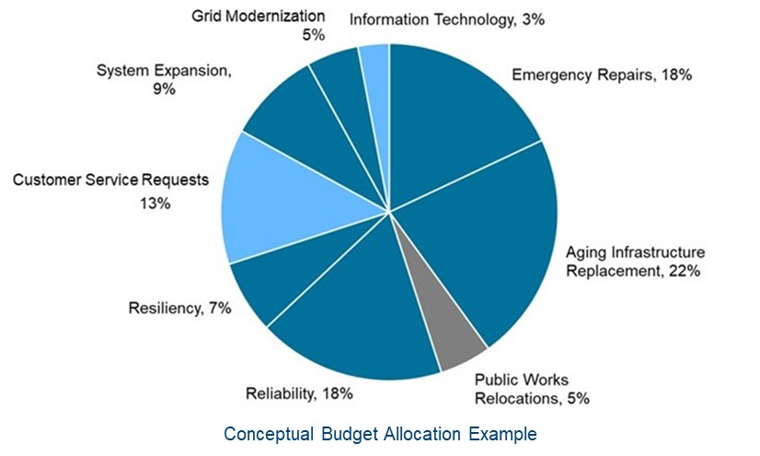
Distribution Investments Are Interdependent
Most distribution capital investments contribute to achieving multiple objectives.

Slide 8
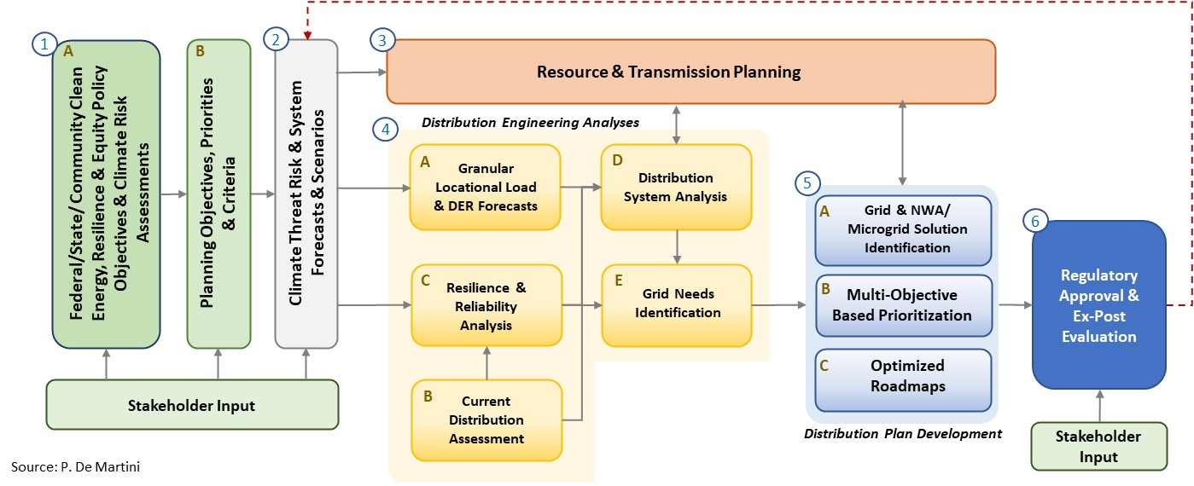
Integrated Resilient Distribution Planning Process Elements (based on emergent best practices)
Updated process flow to reflect emergent best practices regarding stakeholder engagement, resilience integration and multi-objective investment portfolio development
Source: P. De Martini, J. Taft and A. De Martini, Integrated Resilient Distribution Planning, Pacific Northwest National Laboratory, 2022

Slide 9
Questions Public Utility Commissions Can Ask
Multi-objective planning requirements and significantly different uses of the distribution system are driving an increasingly complex planning process.
What are the appropriate planning objectives and criteria for your distribution systems?
How should the uncertainty of the pace and scope of change be addressed?
What is the appropriate investment prioritization model recognizing multiple objectives and multiple benefits?
What level of collaboration is required to ensure we can achieve the desired objectives with a resilient and safe electric grid?
What level of oversight and transparency is required to ensure objectives are achieved and stakeholder buy-in?

Slide 10
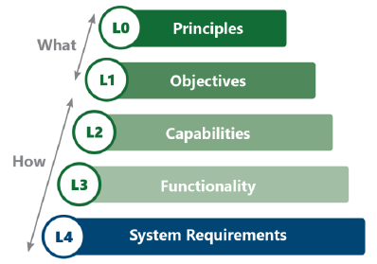
Grid Architecture Approach
Grid modernization planning starts with objectives and capabilities needed.
Scale and scope of needs require a holistic architectural approach.
Resist temptation to start with technology choices.

Slide 11
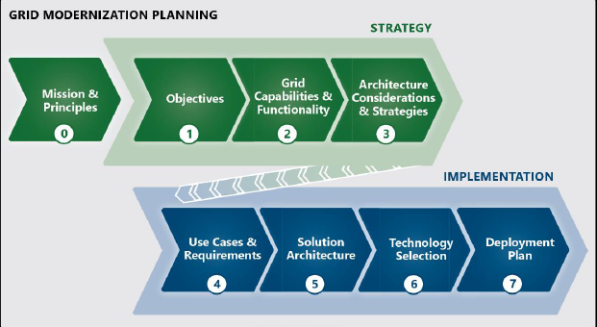
Grid Mod Strategy & Planning Process
What, Why, How, When and How Much
DSPx Guidebook, Vol. 4, 2020
While encouraged, it is not essential to start with a grid mod strategy. But a clear set of objectives is necessary to develop and assess implementation plans.

Slide 12
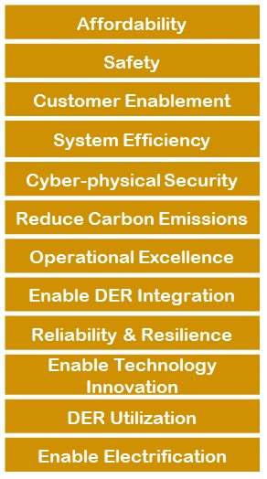
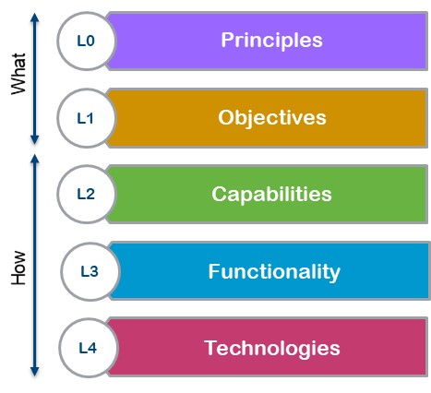
Objectives Drive Grid Mod Planning
Common Objective Themes
PUC Ohio example:
A Strong Grid: A distribution grid that is reliable and resilient, optimized and efficient and planned in a manner that recognizes the necessity of a changing architectural paradigm.
The Grid as a Platform: A modern grid that serves as a secure open access platform—firm in concept and as uniform across our utilities as possible—that allows for varied and constantly evolving applications to seamlessly interface with the platform.
A Robust Marketplace: A marketplace that allows for innovative products and services to arise organically and be delivered seamlessly to customers by the entities of their choosing.
The Customer’s Way: An enhanced experience of the customer’s choosing on the application side, whether for reasons arising from financial, convenience, control, environmental, or any other chosen consideration.
Note: The ‘safe, reliable, and affordable’ components were included in the mission statement, which was incorporated into the principles of the PowerForward Roadmap.
DSPx Taxonomy

Slide 13

Grid Modernization Capabilities
Customer needs and policy drive grid capabilities and corresponding enabling business functionality and technology
 |  | Objectives
 |  | Safety & Operational Efficiency | Reliability & Resilience | DER Integration & Utilization
Capabilities | Market Operations
 | Grid Operations
 | Planning
New
Existing
This analysis helps to identify the core platform functions and related technologies as well as the applications linked to specific policies/customer needs/locational value realization.

Slide 14
Taxonomy Example
Objective | Capability | Function | Technology
Reliability improvement by reducing customer unplanned outage durations Achieve 2nd quartile CAIDI performance by 2025 | Improve outage identification and customer service restoration | Fault Identification Fault Location Fault Isolation Service Restoration | Fault Current Indicators Outage Notification from Meters Outage Management System Geospatial Information System Distribution Management System and/or SCADA Automated Switches Work Management System

Slide 15
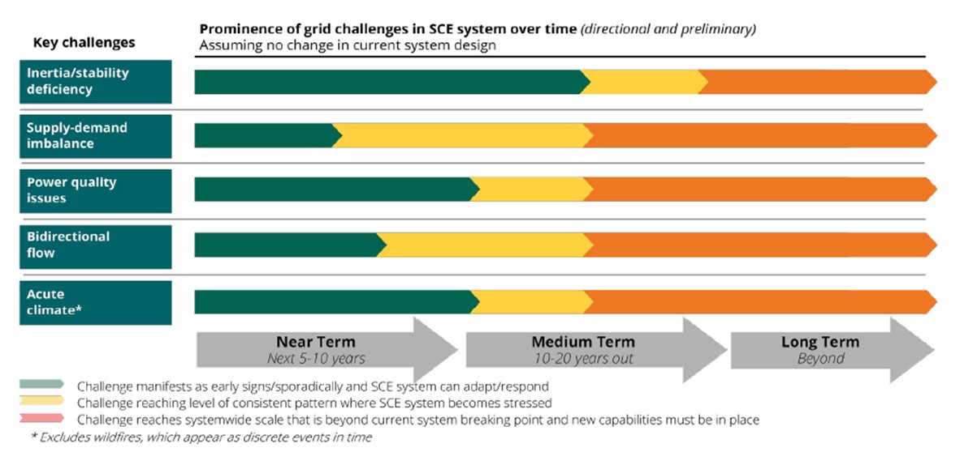
When Are Functions Needed?
Grid modernization functionality and related technologies are largely driven by changes in resource mix, use of the distribution grid, and climate impacts.
Source: Southern California Edison

Slide 16
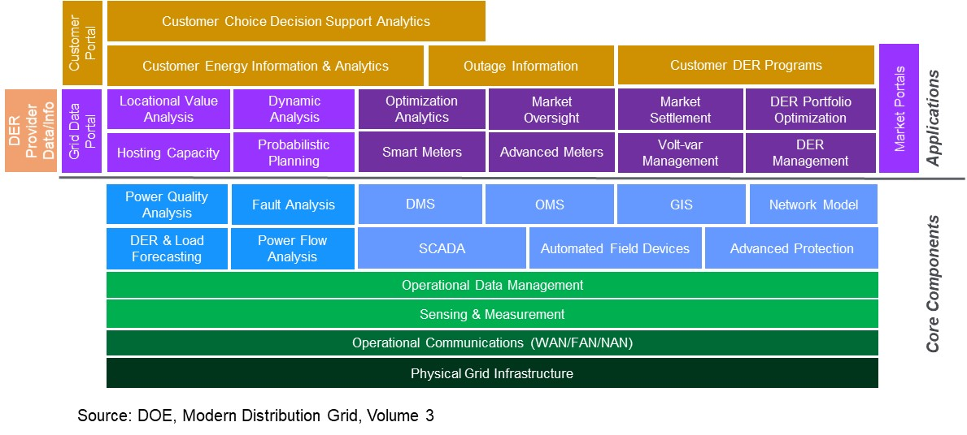
Distribution System Platform
Logical layering of core components that enable specific applications
Green - Core Cyber-physical layer
Blue - Core Planning & Operational systems
Purple - Applications for Planning, Grid & Market Operations
Gold - Applications for Customer Engagement with Grid Technologies
Orange - DER Provider Application
Source: U.S. Department of Energy-Office of Electricity Delivery and Energy Reliability, 2017. Modern Distribution Grid, Volume III: Decision Guide.

Slide 17
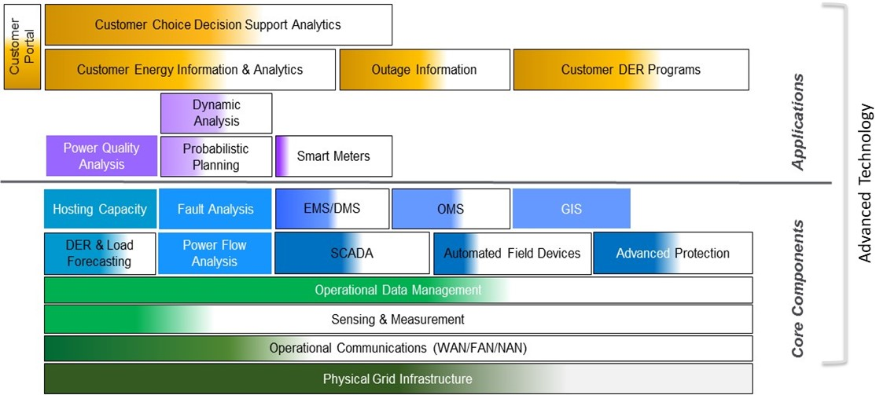
Identify Starting Point for Grid Investment
Summary illustration of a more complete assessment (documented in narrative and tables) to enable a gap analysis against objectives and identified capabilities and functionalities
Source: Hawaiian Electric 2017

Slide 18
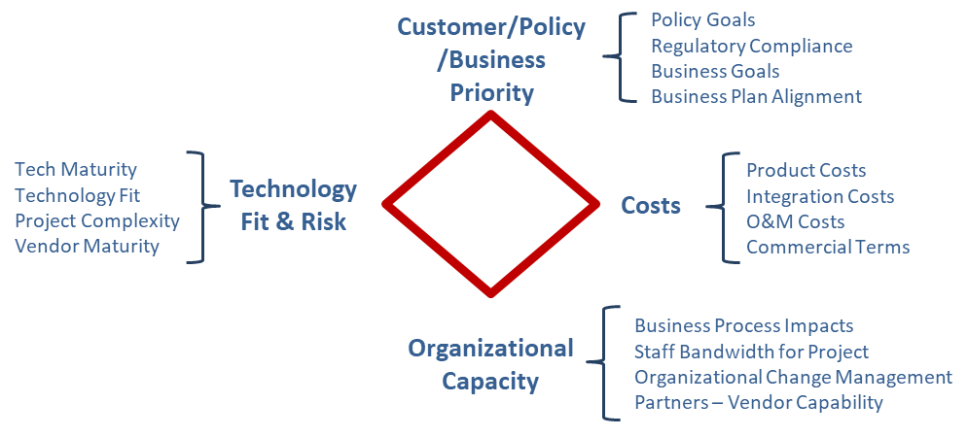
Technology Decision Criteria
General framework for technology assessment within a stage gate sequence where the evaluation begins with conceptual screening on a set of these criteria and increasingly becomes more detailed and definitive in terms of the quantitative and qualitative assessment.

Slide 19
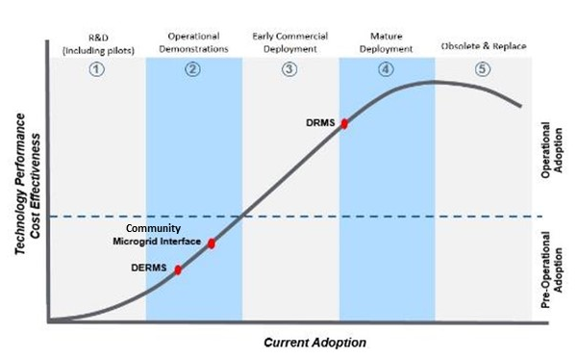
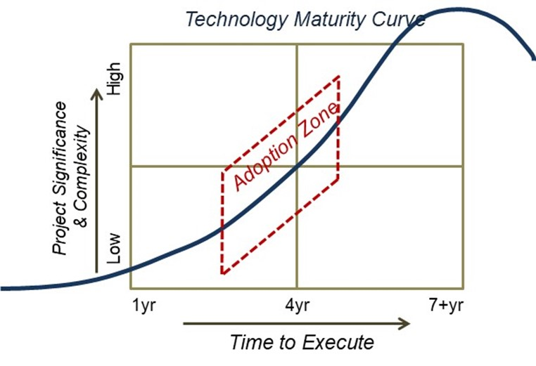
Technology Adoption Considerations
Deciding when to adopt grid technologies involves several factors: technology maturity, time to deploy, implementation complexity and functional criticality.
Technology Maturity Assessment
Technology Adoption Strategy
Source (above): U.S. Department of Energy-Office of Electricity, 2017. Modern Distribution Grid, Volume II: Advanced Technology Maturity Assessment.

Slide 20
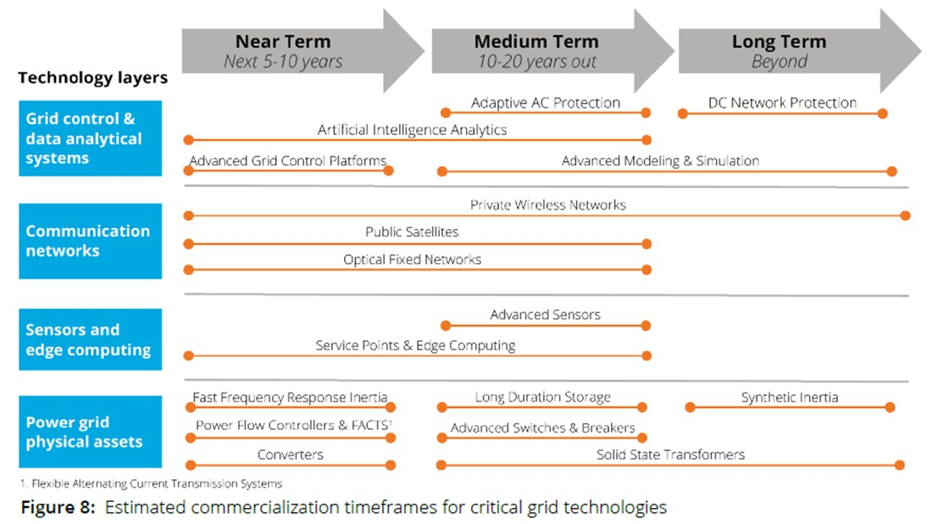
Example Technology Maturity Assessment
Grid modernization plans should consider evolution of technology innovation and commercial availability, including the underlying assessment criteria.
Estimated Commercialization Timeframes for Critical Grid Technologies
Source: Southern California Edison

Slide 21
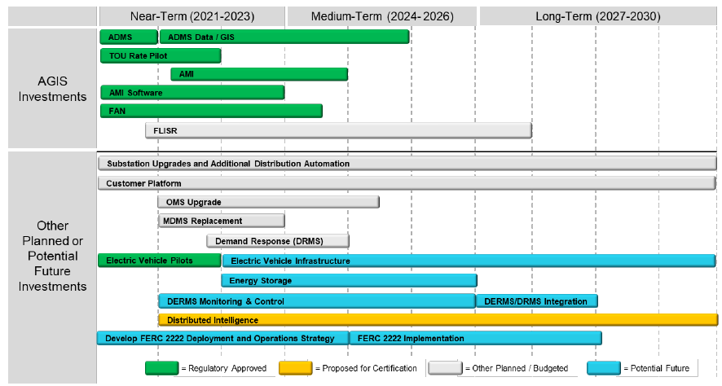
Sequencing of Investments Based on Timing of Need and Technology Maturity
Long-term strategic plan of distribution grid investments
From Xcel Energy’s 2021 Integrated Distribution Plan

Slide 22
Questions Public Utility Commissions Can Ask
Have clear modernization objectives been established in policy or regulation, or proposed by the utility?
Has a clear starting point for modernization been identified?
What is the pace and scope of change expected over the planning period, and does the grid mod plan address the needs?
Are grid mod plans aligned and integrated with asset management and resilience planning?
Do grid mod plans incorporate flexibility needed for the uncertainty in needs and emergent grid technologies?

Slide 23
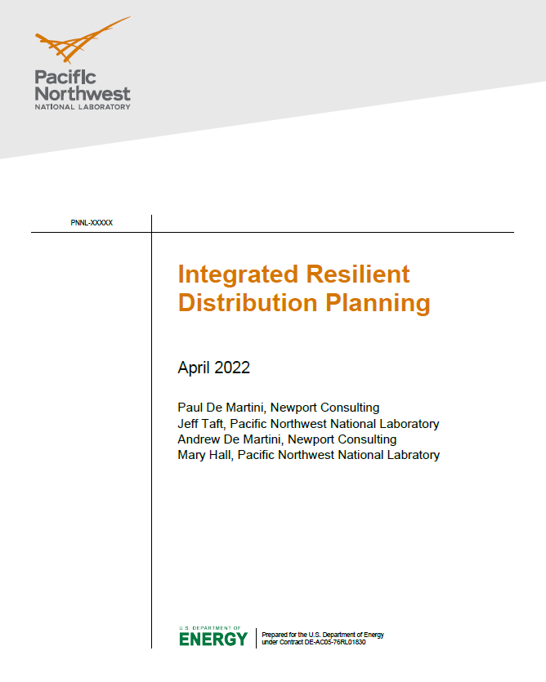
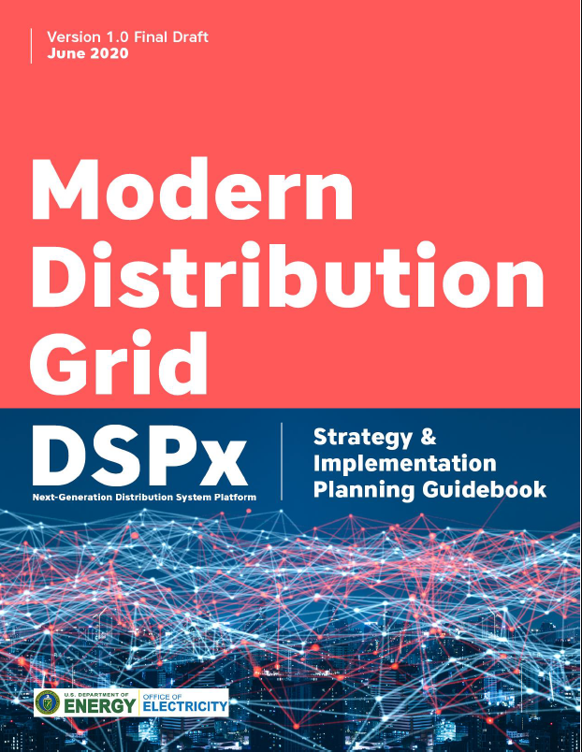

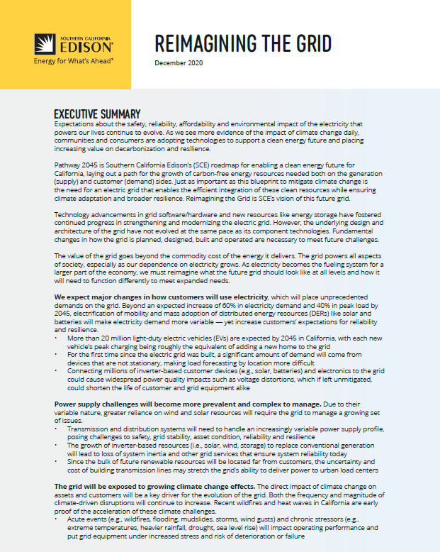
Resources for More Information
Contact:
Joe Paladino, joseph.paladino@hq.doe.gov
Paul De Martini, paul@newportcg.com
References:
Integrated Resilient Distribution Planning
(forthcoming)
DSPx Guidebook
2020
PUCO Grid Mod Roadmap
DTE’s IRDP & Grid Mod Plan Using DSPx
SCE Grid Modernization Strategy
https://gridarchitecture.pnnl.gov/media/Modern-Distribution-Grid_Volume_IV_v1_0_draft.pdf
https://puco.maps.arcgis.com/apps/Cascade/index.html?appid=59a9cd1f405547c89e1066e9f195b0b1
https://mi-psc.force.com/s/filing/a00t000000RaTD3AAN/u201470071
https://newsroom.edison.com/_gallery/get_file/?file_id=5fcfb5f62cfac23b06eb7d39&ir=1

Slide 24
Thank you

