Slide 1
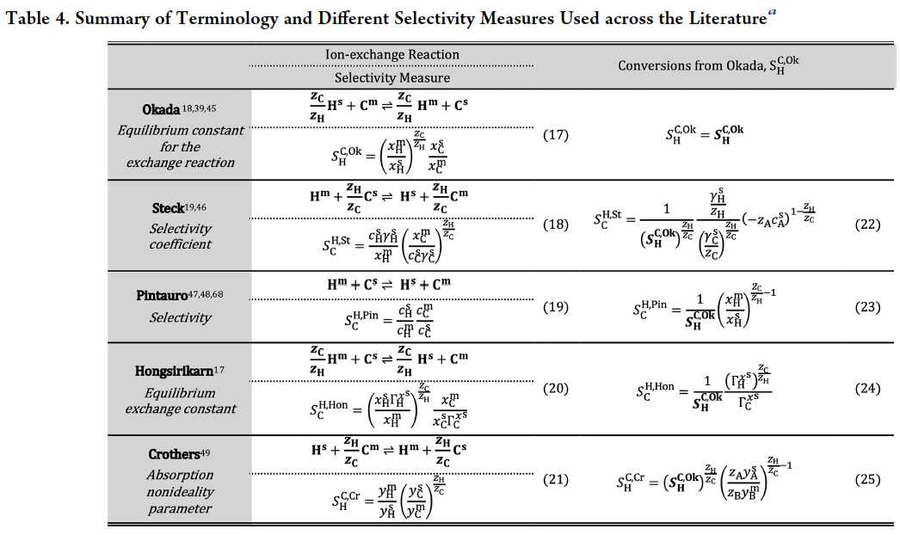
Coalescing Cation Selectivity Approaches in Ionomers
Thermodynamics of non-ideal Donnan phase equilibrium was revisited to arrive at a rigorous understanding of selectivity coefficients as measures of phase non-ideality and cation dissimilarity
Hidden dimensionality in the dimensionless selectivity coefficients was analyzed to identify points of divergence between the measures used by different studies
  These dimensions include concentration measures used, the form of the ion-exchange reaction considered, and whether phase non-idealities are included in the measure definition
Correlation studies showed that selectivity (vs protons) is a function of cation valence and radius; more data for multivalent cations is needed to make the inference stronger
Reconciled the various definitions and expressions used to quantify the cation-selectivity of a membrane
Developed a cohesive database of binary selectivity coefficients (mono-, di-, and tri-valent cations vs protons) for Nafion
Conversion scheme for interconverting between selectivity measures can be applied to standardize reported values for a wide range of materials
Nafion database was instrumental in being able to explore correlations between cation properties and selectivity
P. Goyal, A. Kusoglu, and A.Z. Weber (2023). Coalescing Cation Selectivity Approaches in Ionomers, ACS Energy Letters, 8, 1551–1566. https://doi.org/10.1021/acsenergylett.3c00163

