Slide 1
End-use Load Profiles for the U.S. Building Stock
Technical Advisory Group Meeting #10
April 21, 2021
Natalie Mims Frick, LBNL

Slide 2
Logistics
We are recording the webinar and breakout groups.
Because of the large number of participants on the phone, please keep yourself muted during presentations.
Please use the chat box to send us clarifying questions during presentations. You can chat or unmute yourself to ask a question during our designated discussion time.
Links to the slides are in the chat box.

Slide 3
Today’s agenda
 | Mountain Time
Welcome | 10:00 - 10:05
Calibration progress summary | 10:05 - 10:25
Residential calibration update | 10:25 - 11:10
Breakout room 1: Deep dive on residential calibration Breakout room 2: Project recap | 11:10 – 11:45
Break | 11:45 – 11:50
Breakout room 1: A method for developing general load profiles for industry Breakout room 2: Cambium: a public dataset of hourly marginal carbon emissions and avoided cost metrics for the electric sector through 2050. | 11:50 - 12:25
Breakout room 1: Building electrification load modeling panel Breakout room 2: Distributed PV Adoption Modeling with dGen | 12:25 - 1:00

Slide 4
Project Overview
Hybrid approach combines
best-available ground-truth data—
submetering studies,
whole-building interval meter data, and
other emerging data sources
—with the reach, cost-effectiveness, and granularity of physics-based and data-driven building stock modeling capabilities
The novel approach delivers a nationally-comprehensive dataset at a fraction of the historical cost.

Slide 5
Project Timeline
Year 1
Year 2
Year 3
Beyond
Technical Advisory Group
You are here
Com: 2 of 4 calibration regions complete
Res: 4 of 5 calibration regions complete
Define use cases and requirements
Collect/review existing data
Report on market needs and data gaps
Targeted data acquisition leveraging planned/ongoing sub-metering studies
Data analysis to derive occupant-driven schedules and usage diversity
Rigorous calibration of building stock end-use models
Quantify accuracy of results for target applications
Calibrated
building stock models
EE/DR savings profiles
Stochastic occupancy modeling capabilities
Load profile library,
documentation, & user guide
Ongoing additions to load profile library

Slide 6
Summary of FY21 Final Products for End-Use Load Profiles
Published by 9/30/2021
Public Datasets
VizStock Web Interface
Pre-aggregated Load Profiles
Raw Individual Building Load Profiles
Raw Individual Building Models
Dataset Access Instructions
The project website will provide instructions on how to access and download the various dataset formats
Completed by 9/30/2021
Webinar
Conduct public outreach webinar to TAG and other stakeholders to present project outcomes
Drafts to
DOE & TAG by 9/30/2021
Final reports published by 12/31/2021
EERE or NREL report
End-Use Load Profiles for the U.S. Building Stock: Methodology and Results of Model Calibration, Validation, and Uncertainty Quantification
Content: Detailed description of model improvements made for calibration; detailed explanation of validation and uncertainty of results
Audience: Dataset and model users interested in technical details
NREL lead; LBNL and ANL co-authors
EERE or LBNL report
End-Use Load Profiles for the U.S. Building Stock: Applications and Opportunities
Content: Example applications and opportunities for using the dataset
Audience: General users of datasets
LBNL lead; NREL co-authors

Slide 7
Resources
Publications
Li et al. Characterizing Patterns and Variability of Building Electric Load Profiles in Time and Frequency Domain
Bianchi et al. 2020. Modeling occupancy-driven building loads for large and diversified building stocks through the use of parametric schedules
Parker et al. 2020. Framework for Extracting and Characterizing Load Profile Variability Based on a Comparative Study of Different Wavelet Functions
Present et al. 2020. Putting our Industry’s Data to Work: A Case Study of Large Scale Data Aggregation
Northeast Energy Efificency Partnership (NEEP). 2020. Sharing Load Profile Data: Best Practices and Examples
Frick et al. 2019. End-Use Load Profiles for the U.S. Building Stock: Market Needs, Use Cases, and Data Gaps
N. Frick. 2019. End Use Load Profile Inventory
E.Present and E. Wilson. 2019. End use load profiles for the U.S. Building Stock
Presentations and Slides
Technical Advisory Group slides
  LBNL and NREL site
E. Wilson. 2020. EFX webinar
E. Wilson. 2019. E Source interview
E. Wilson. 2019. Peer Review presentation
E. Present. 2019. NEEP presentation.
Software
OpenStudio Occupant Variability Gem and Non Routine Variability Gem (more info at IBPSA newsletter)
Data
First year of 15-min NEEA HEMS data available: https://neea.org/data/end-use-load-research/energy-metering-study-data

Slide 8
End-Use Load Profiles for the U.S. Building Stock: Calibration Progress Summary
Eric Wilson, Andrew Parker
April 21, 2021
Notes:
Residential and Commercial calibration updates today and tomorrow will present lots of graphs with the details of progress that’s been made
We wanted to give you all a more qualitative sense of how it has been going.

Slide 9
Project Timeline
FY19 (ends 9/30/2019)
FY20 (ends 9/30/2020)
FY21 (ends 9/30/2021)
Beyond
Technical Advisory Group
You are here
Com: 2 of 4 calibration regions complete
Res: 4 of 5 calibration regions complete
Define use cases and requirements
Collect/review existing data
Report on market needs and data gaps
Targeted data acquisition leveraging planned/ongoing sub-metering studies
Data analysis to derive occupant-driven schedules and usage diversity
Rigorous calibration of building stock end-use models
Quantify accuracy of results for target applications
Calibrated
building stock models
EE/DR savings profiles
Stochastic occupancy modeling capabilities
Load profile library,
documentation, & user guide
Ongoing additions to load profile library
Notes:
We are moving right along in our project timeline. We are already in our second quarter of our fiscal quarter for this project. We anticipate that the final load profiles and models will be available in September of this year, along with model documentation and a user guide.

Slide 10


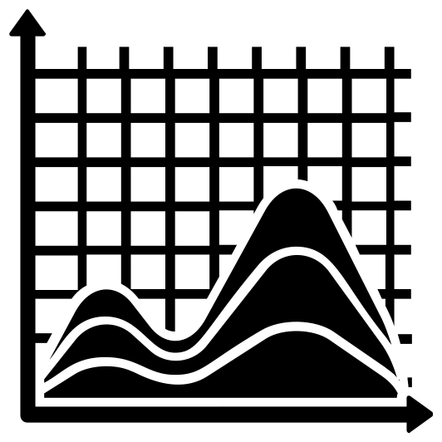

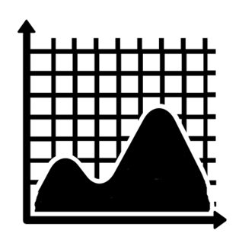
Solution: A Hybrid Approach (2)
End-use data for sampled buildings
End-use profiles for sample
Whole-building/sector data from multiple regions
Aggregate AMI load profile for each building type in a region

Slide 11




Solution: A Hybrid Approach (2)
National ResStock/ComStock characteristics data
End-use data for sampled buildings
End-use profiles for sample
Whole-building/sector data from multiple regions
Aggregate AMI load profile for each building type in a region
Validated at both the end use level and population level
Models calibrated to both end-use sample and AMI population data

Slide 12
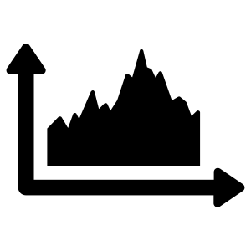
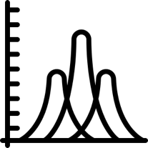
Solution: A Hybrid Approach (2)
Realistic stochastic typical building profiles
National ResStock/ComStock characteristics data
End-use data for sampled buildings
End-use profiles for sample
Whole-building/sector data from multiple regions
Aggregate AMI load profile for each building type in a region
Validated at both the end use level and population level
Validated diversity and individual typical building profiles as well
(enables more use cases)
Models calibrated to both end-use sample and AMI population data
Schedule and occupant behavior diversity

Slide 13
Guiding Principles
We want to get the “why” right so we can ask questions about changes to the stock (i.e., savings load shapes)
Make changes that are supported by data and domain experience, not simply to get a better fit
Report out accuracy and uncertainty so users can decide if they want to use
Calibrating outputs (true-up model) may be appropriate in some instances

Slide 14
Guiding Principles
We want to get the “why” right so we can ask questions about changes to the stock (i.e., savings load shapes)
Make changes that are supported by data and domain experience, not simply to get a better fit
Report out accuracy and uncertainty so users can decide if they want to use
Calibrating outputs (true-up model) may be appropriate in some instances

Slide 15
Guiding Principles
We want to get the “why” right so we can ask questions about changes to the stock (i.e., savings load shapes)
Make changes that are supported by data and domain experience, not simply to get a better fit
Report out accuracy and uncertainty so users can decide if they want to use
Notes:
There is uncertainty in both modeled outputs and the measured/truth data
There is no target error for calibration (constrained by budget)

Slide 16
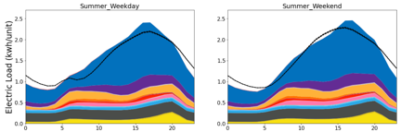
Quantities of Interest (QOI) by building type and region
Annual energy use (MWh)
Average daily minimum magnitude (MW)
  Summer, All days
  Winter, All days
  Shoulder, All days
Average daily maximum magnitude (MW)
  Summer, All days
  Summer, Top 10 days
  Winter, All days
  Winter, Top 10 days
  Shoulder, All days
Hour of day (0-23)
Average daily maximum load timing (hour of day)
  Summer, All days
  Summer, Top 10 days
  Winter, All days
  Winter, Top 10 days
  Shoulder, All days

Slide 17





Residential Calibration Dimensions
Res. Calibration
EIA Form 861
EIA 861m electricity, natural gas data
EIA RECS
modeled end-uses
Utility load research data (LRD)
Region 1 AMI data
Region 2 AMI data
Region 3 AMI data
Region 4 AMI data
Region 5 AMI data
Submeter end-uses
Annual electric sales of all utilities in U.S.
AMI data from Vermont; Cherryland, MI
Annual and monthly electricity and natural gas consumption by state, sector
AMI data from Electric Power Board of Chattanooga, TN
Horry Electric (SC), and City of Tallahassee, FL
Annual end-use loads of occupied dwelling units
Building type
Climate zone
Fuel (electricity, natural gas, propane, fuel oil)
AMI data (aggregated by building type) from
Seattle City Light, WA
Sub-metered end-use load data
(5 datasets)
AMI data from Fort Collins municipal service territory (CO)
Load duration curves and seasonal load shapes of ~16 utilities around U.S.
Advanced metering infrastructure (AMI) data from ComEd service territory (IL)

Slide 18
Summary of Residential AMI Calibration Regions
3
Seattle City Light
5
Vermont
(VEIC)
5
Cherryland, MI
Fort Collins Utilities, CO
ComEd
1
2
EPB Chattanooga, TN
4
LADWP
(completed under previous project)
4
Horry Electric Co-op
4
Tallahassee, FL
Using AMI data from over
2.3 million meters (res. + com.)
Background colors are DOE Building America Climate Regions

Slide 19
Summary of Residential Submeter Datasets
3
Seattle City Light
NEEA RBSA Metering
NEEA HEMS Metering
5
Vermont
(VEIC)
5
Cherryland, MI
Fort Collins Utilities, CO
Mass RES 1 Baseline Study
ComEd
1
2
EPB Chattanooga, TN
4
LADWP
(completed under previous project)
4
Horry Electric Co-op
Pecan St. Dataport
4
Tallahassee, FL
FSEC PDR Metering
Background colors are DOE Building America Climate Regions

Slide 20
Commercial Calibration Dimensions
Annual and monthly electricity and natural gas consumption by state, sector
Com. Calibration
EIA 861m electricity, natural gas
EIA CBECS
Utility load research data (LRD)
Region 1 AMI data
Region 2 AMI data
Region 3 AMI data
Region 4 AMI data
Submetered end-uses
AMI data from (likely)
Horry County, SC;
Chatanooga TN;
Tallahassee, FL
Annual gas and electricity EUIs by building type
AMI data from Vermont; Maine; Cherryland, MI
Sub-metered end-use load data
AMI data (aggregated by building type) from
Seattle City Light, WA and Portland General Electric, OR
Load duration curves and seasonal load shapes of ~16 utilities around U.S.
AMI data from Fort Collins municipal service territory (CO)

Slide 21
Summary of Commercial AMI Calibration Regions
Seattle City Light
Region 5 (planned)
2
2
Portland General Electric
Vermont
(VEIC)
3
Portland, Maine (Efficiency Maine)
3
3
Cherryland, MI
Fort Collins Utilities, CO
1
EPB Chattanooga, TN
4
Horry County, SC
LADWP
(completed under previous project)
4
Critical for Commercial:
Customer metadata
(building type, floor area)
Detection of misclassification and outliers
Region 4
4
Tallahassee, FL
Using AMI data from over
2.3 million meters (res. + com.)
Background colors are DOE Building America Climate Regions

Slide 22
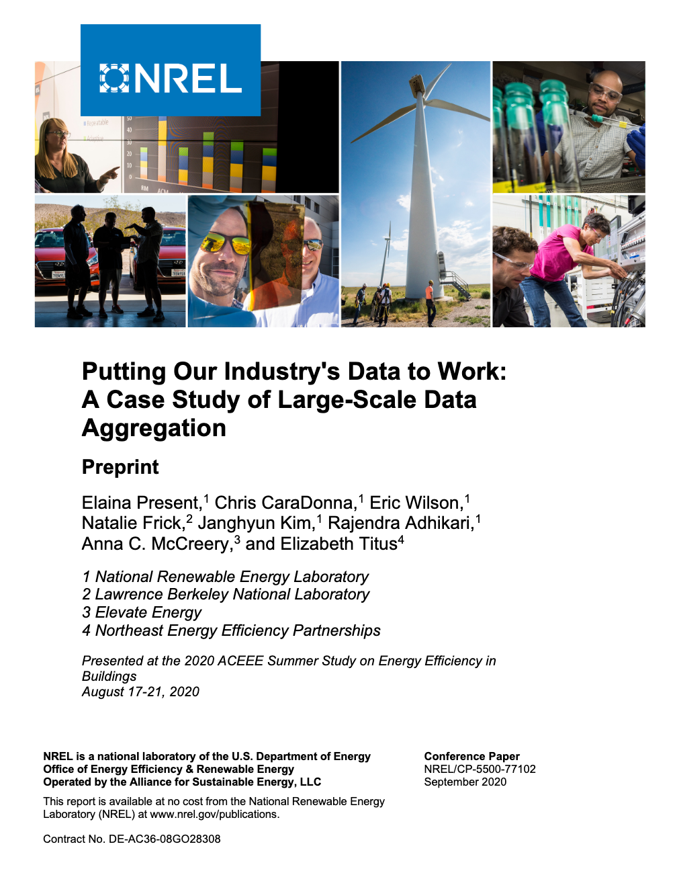
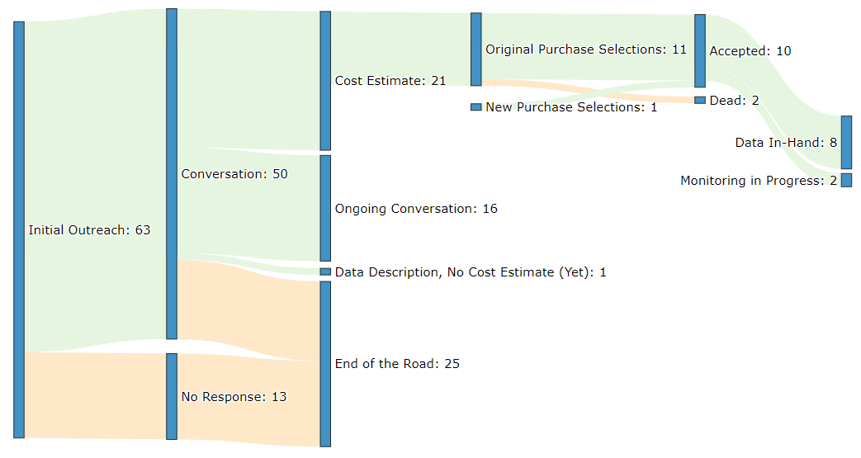
Commercial End-Use Data Procurement
Summary
  Major outreach effort, >700 hours
  10 datasets purchased
https://www.nrel.gov/docs/fy20osti/77102.pdf
Notes:
Commercial submeter data:
Conducted targeted outreach
Talked to 50 companies
Looks like we will be able to get reasonable coverage, currently procuring data
Expecting a range of data quality
Go/no-go end of February

Slide 23
So how’s it going?

Slide 24
Residential Calibration
Significant quantity of interest (QOI) improvements seen across four calibration focus regions, load research data, and EIA data comparisons
Remaining areas of concern include electric heating and heating/cooling behavior during shoulder seasons
  Focusing on these for final region
  In parallel, developing true-up model to address behavior not captured by simulations
Our research found that appliance, lighting, and plug load shapes are highly transferrable between regions
  But the magnitudes are not; we incorporated data on how these end uses vary by region
Made many enhancements to the diversity and granularity of EULPs, which don’t show up in the main QOIs
Region 5 of 5 to finish in July 2021

Slide 25
Residential Calibration
Significant quantity of interest (QOI) improvements seen across four calibration focus regions, load research data, and EIA data comparisons
Remaining areas of concern include electric heating and heating/cooling behavior during shoulder seasons
  Focusing on these for final region
  In parallel, developing true-up model to address behavior not captured by simulations
Our research found that appliance, lighting, and plug load shapes are highly transferrable between regions
  But the magnitudes are not; we incorporated data on how these end uses vary by region
Made many enhancements to the diversity and granularity of EULPs, which don’t show up in the main QOIs
Region 5 of 5 to finish in July 2021
Notes:
Cautiously applied monthly scaling to heating and cooling end uses only; validating use of true-up model using holdout hourly data

Slide 26
Residential Calibration
Significant quantity of interest (QOI) improvements seen across four calibration focus regions, load research data, and EIA data comparisons
Remaining areas of concern include electric heating and heating/cooling behavior during shoulder seasons
  Focusing on these for final region
  In parallel, developing true-up model to address behavior not captured by simulations
Our research found that appliance and plug load shapes are highly transferrable between regions
  But the magnitudes are not; we incorporated data on how these end uses vary by region
Made many enhancements to the diversity and granularity of EULPs, which don’t show up in the main QOIs
Region 5 of 5 to finish in July 2021

Slide 27
Residential Calibration
Significant quantity of interest (QOI) improvements seen across four calibration focus regions, load research data, and EIA data comparisons
Remaining areas of concern include electric heating and heating/cooling behavior during shoulder seasons
  Focusing on these for final region
  In parallel, developing true-up model to address behavior not captured by simulations
Our research found that appliance and plug load shapes are highly transferrable between regions
  But the magnitudes are not; we incorporated data on how these end uses vary by region
Made many enhancements to the diversity and granularity of EULPs, which don’t show up in the main QOIs
Region 5 of 5 to finish in July 2021

Slide 28
Residential Calibration
Significant quantity of interest (QOI) improvements seen across four calibration focus regions, load research data, and EIA data comparisons
Remaining areas of concern include electric heating and heating/cooling behavior during shoulder seasons
  Focusing on these for final region
  In parallel, developing true-up model to address behavior not captured by simulations
Our research found that appliance and plug load shapes are highly transferrable between regions
  But the magnitudes are not; we incorporated data on how these end uses vary by region
Made many enhancements to the diversity and granularity of EULPs, which don’t show up in the main QOIs
Region 5 of 5 to finish in July 2021

Slide 29
Commercial Calibration
Getting an accurate ground truth to use for calibration is challenging and critical
  Submeter data not readily available, we had to get creative and procure from a range of companies
  AMI data is only useful if you know building type and size, so we had to develop ways to match metadata that avoid privacy concerns
  Developed process for removing outliers (e.g., misclassified building types, missing meters)
  AMI sample size is small for some utility/building type combos – can't rely on AMI alone
  Comparisons to EIA, CBECS, and Load Research Data will be important to add
Making model improvements in parallel, which have resulted in modest improvements in annual energy, peak magnitude, and peak timing
Quantity of interest (QOI) comparisons show we have a ways to go
Including some enhancements to the diversity and granularity of EULPs, which don’t show up in the main QOIs
Region 3 of 4 to finish in May 2021, Region 4 of 4 to finish in August 2021

Slide 30
Commercial Calibration
Getting an accurate ground truth to use for calibration is challenging and critical
  Submeter data not readily available, we had to get creative and procure from a range of companies
  AMI data is only useful if you know building type and size, so we had to develop ways to match metadata that avoid privacy concerns
  Developed process for removing outliers (e.g., misclassified building types, missing meters)
  AMI sample size is small for some utility/building type combos – can't rely on AMI alone
  Comparisons to EIA, CBECS, and Load Research Data will be important to add
Making model improvements in parallel, which have resulted in modest improvements in annual energy, peak magnitude, and peak timing
Quantity of interest (QOI) comparisons show we have a ways to go
Including some enhancements to the diversity and granularity of EULPs, which don’t show up in the main QOIs
Region 3 of 4 to finish in May 2021, Region 4 of 4 to finish in August 2021

Slide 31
Commercial Calibration
Getting an accurate ground truth to use for calibration is challenging and critical
  Submeter data not readily available, we had to get creative and procure from a range of companies
  AMI data is only useful if you know building type and size, so we had to develop ways to match metadata that avoid privacy concerns
  Developed process for removing outliers (e.g., misclassified building types, missing meters)
  AMI sample size is small for some utility/building type combos – can't rely on AMI alone
  Comparisons to EIA, CBECS, and Load Research Data will be important to add
Making model improvements in parallel, which have resulted in modest improvements in annual energy, peak magnitude, and peak timing
Quantity of interest (QOI) comparisons show we have a ways to go
Including some enhancements to the diversity and granularity of EULPs, which don’t show up in the main QOIs
Region 3 of 4 to finish in May 2021, Region 4 of 4 to finish in August 2021

Slide 32
Commercial Calibration
Getting an accurate ground truth to use for calibration is challenging and critical
  Submeter data not readily available, we had to get creative and procure from a range of companies
  AMI data is only useful if you know building type and size, so we had to develop ways to match metadata that avoid privacy concerns
  Developed process for removing outliers (e.g., misclassified building types, missing meters)
  AMI sample size is small for some utility/building type combos – can't rely on AMI alone
  Comparisons to EIA, CBECS, and Load Research Data will be important to add
Making model improvements in parallel, which have resulted in modest improvements in annual energy, peak magnitude, and peak timing
Quantity of interest (QOI) comparisons show we have a ways to go
Including some enhancements to the diversity and granularity of EULPs, which don’t show up in the main QOIs
Region 3 of 4 to finish in May 2021, Region 4 of 4 to finish in August 2021

Slide 33
Commercial Calibration
Getting an accurate ground truth to use for calibration is challenging and critical
  Submeter data not readily available, we had to get creative and procure from a range of companies
  AMI data is only useful if you know building type and size, so we had to develop ways to match metadata that avoid privacy concerns
  Developed process for removing outliers (e.g., misclassified building types, missing meters)
  AMI sample size is small for some utility/building type combos – can't rely on AMI alone
  Comparisons to EIA, CBECS, and Load Research Data will be important to add
Making model improvements in parallel, which have resulted in modest improvements in annual energy, peak magnitude, and peak timing
Quantity of interest (QOI) comparisons show we have a ways to go
Including some enhancements to the diversity and granularity of EULPs, which don’t show up in the main QOIs
Region 3 of 4 to finish in May 2021, Region 4 of 4 to finish in August 2021

Slide 34
Looking Ahead
Quantitative accuracy assessments will be presented:
  Residential Calibration Update (up next)
  Commercial Calibration Update (tomorrow)
Final calibration updates presented to TAG in August 2021
Final assessments will be published in the Methodology and Results report (draft in Sept.)

Slide 35
Sample Sizes: Weather-driven End Uses
Weather-driven | Proposed Minimum Sample Size¹ | Oct 31st Package Sample Size² | Procured Sample Size³
Heating | 48 | 6218 | 5176
Cooling | 48 | 6598 | 5351
Fans | 21 | 2497 | 328
Pumps | 21 | 500 | 83
Heat Rejection | 21 | 21 | 41
Humidification | 21 | 27 | 22
Heat Recovery | 21 | 22 | 36
Refrigeration | 21 | 1076 | 1010
Exterior Lighting | 21 | 846 | 846
No gaps identified
¹Minimum sample size targets presented at subject matter expert webinar on 8/28/2019.
²Counts based on vendor rough estimates obtained during market outreach
³Procured Sample Size includes data in hand and data that is being contracted for procurement
Notes:
These are minimums
Across all regions and building types (similar to CEMS)
More samples for heating and cooling to cover different system component types (e.g. elec res vs. heat pump)
Sample size is not only driver of accuracy—just one of several tiers/strategies.

Slide 36
Sample Sizes: Schedule-driven End Uses
Schedule-driven |  | Hospital | Outpatient | Primary School | Secondary School | Full-Service Restaurant | Quick Service Restaurant | Retail | Strip Mall | Supermarket | Small Hotel | Large Hotel | Warehouse | Multifamily | Small Office | Medium Office | Large Office
Proposed Minimum Sample Size¹ | Interior Lighting | 21 |  | 21 |  | 21 |  | 21 |  | 21 | 21 |  | 21 | n/a | 21
 | Interior Equipment | 21 |  | 21 |  | 21 |  | 21 |  | 21 | 21 |  | 21 | n/a | 21
 | Service Water Heating | 0 |  | 0 |  | 0 |  | 0 |  | 0 | 0 |  | 0 | n/a | 0
 | Cooking | n/a |  | n/a |  | n/a |  | n/a |  | n/a | n/a |  | n/a | n/a | n/a
Oct 31st Package Sample Size² | Interior Lighting | 103 |  | 281 |  | 760 |  | 1046 |  | 137 | 53 |  | 270 | 20 | 337
 | Interior Equipment | 2 |  | 285 |  | 196 |  | 214 |  | 4 | 5 |  | 25 | 22 | 270
 | Service Water Heating | 0 |  | 0 |  | 316 |  | 106 |  | 0 | 0 |  | 0 | 0 | 1
 | Cooking | 0 |  | 2 |  | 2618 |  | 0 |  | 0 | 1 |  | 0 | 0 | 0
Procured Sample Size³ | Interior Lighting | 76 |  | 162 |  | 710 |  | 800 |  | 71 | 42 |  | 131 | 65 | 118
 | Interior Equipment | 4 |  | 284 |  | 200 |  | 196 |  | 3 | 2 |  | 50 | 367 | 53
 | Service Water Heating | 0 |  | 0 |  | 317 |  | 107 |  | 1 | 0 |  | 15 | 98 | 1
 | Cooking | 0 |  | 0 |  | 2620 |  | 1 |  | 1 | 0 |  | 0 | 0 | 0
¹Minimum sample size targets presented at subject matter expert webinar on 8/28/2019.
²Counts based on vendor rough estimates obtained during market outreach
³Procured Sample Size includes data in hand and data that is being contracted for procurement
=gap
Notes:
These are minimums
Sample size is not only driver of accuracy—just one of several tiers/strategies.
CBECS shows very small electricity usage for SWH, so we propose minimums of zero (though we will get some data).
Hypothesize that these transfer across regions (as proposed in KEMA 2009)
AMI data can be used to derive differences in operating hours.

Slide 37
Residential Region 4 Calibration
Anthony D. Fontanini, Ph.D.
Eric Wilson
April 21, 2021

Slide 38
Calibration Strategy

Slide 39






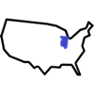
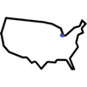



Model Architecture
Housing stock characteristics database
Physics-based
computer modeling
National
Climate/Region
Modeling Algorithms
Schedules
Human Behavior
State
City/CBSA (Core-Based Statistical Area)
Performance Curves
Component Properties
Weather
Data

Slide 40
Region 4 Focus: Nationally-Relevant Updates
LED saturation
Heating setpoints
Cooling setpoints
Housing stock characteristics database
Physics-based
computer modeling
Baseload shifting
Coastal weather
National
Climate/Region
Modeling Algorithms
Schedules
Human Behavior
State
Public Use Microdata Area (PUMA)
Performance Curves
Component Properties
Weather
Data
Notes:
These are all updates that will impact ResStock results across all regions.
We want to address these broad things before going too deep into a specific region.

Slide 41
Region 4 Calibration Strategy
ResStock
Capabilities
Baseload
HVAC
Validation Comparisons
Heating Setpoints by system type
Cooling Setpoints by system type
Vacant unit setpoint assumptions
Impact of coastal weather
Increase EIA monthly loads using PV generation data
Correct for reporting errors in EIA monthly data
2018 LRD data comparisons
AMI data from City of Tallahassee
AMI data from EPB, Chattanooga, TN
AMI data from Horry Electric
California Climate Zone Aggregation
Correction Model
Increase LED saturation
Shift baseloads based on ATUS state and month average schedules

Slide 42
Residential Calibration Dimensions
Adjusted for PV generation and billing periods
Res. Calibration
EIA Form 861
EIA 861m electricity, natural gas data
EIA RECS
modeled end-uses
Utility load research data (LRD)
Region 1 AMI data
Region 2 AMI data
Region 3 AMI data
Region 4 AMI data
Region 5 AMI data
Submeter end-uses
Annual electric sales of all utilities in U.S.
AMI data from Vermont; Cherryland, MI
Annual and monthly electricity and natural gas consumption by state, sector
Annual and monthly electricity and natural gas consumption by state, sector
New
AMI data from Electric Power Board of Chattanooga, TN
Horry Electric (SC), and City of Tallahassee, FL
Annual end-use loads of occupied dwelling units
Building type
Climate zone
Fuel (electricity, natural gas, propane, fuel oil)
AMI data (aggregated by building type) from
Seattle City Light, WA
Sub-metered end-use load data
(5 datasets)
Updated from 2012 to 2018
AMI data from Fort Collins municipal service territory (CO)
Load duration curves and seasonal load shapes of ~16 utilities around U.S.
Advanced metering infrastructure (AMI) data from ComEd service territory (IL)

Slide 43
Summary of Residential AMI Calibration Regions
3
Seattle City Light
Fort Collins Utilities, CO
ComEd
1
2
LADWP
(completed under previous project)

Slide 44
Summary of Residential AMI Calibration Regions
3
Seattle City Light
Fort Collins Utilities, CO
ComEd
1
2
EPB Chattanooga, TN
4
LADWP
(completed under previous project)
4
Horry Electric Co-op
Region 4
4
Tallahassee, FL

Slide 45
Summary of Residential AMI Calibration Regions
Region 5 (current)
3
Seattle City Light
5
Vermont
(VEIC)
5
Cherryland, MI
Fort Collins Utilities, CO
ComEd
1
2
EPB Chattanooga, TN
4
LADWP
(completed under previous project)
4
Horry Electric Co-op
Region 4
4
Tallahassee, FL

Slide 46
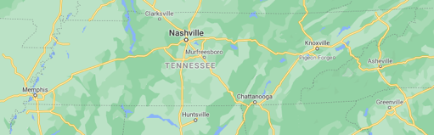
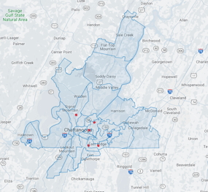
Region 4 – Electric Power Board (EPB) of Chattanooga
Serves ~158,000 customers in TN and GA
Municipal utility
Used AMI data from 2019
Compared to previous regions:
  Higher % electric heating
Building Type RECS | Saturation
Mobile Home | 9.8%
Multi-Family with 2 - 4 Units | 7.3%
Multi-Family with 5+ Units | 10.0%
Single-Family Attached | 2.3%
Single-Family Detached | 70.7%
Heating Fuel | Saturation
Electricity | 70.3%
Fuel Oil | 0.2%
Natural Gas | 22.2%
Other Fuel | 1.8%
Propane | 5.5%

Slide 47
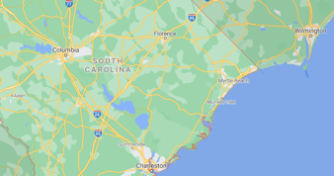
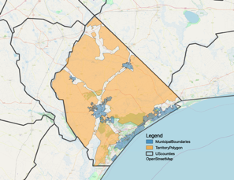
Region 4 – Horry Electric Cooperative
Serves ~68,000 customers in SC
Serves most of Horry County, including several municipalities via franchise agreements
Used AMI data from 2018
Compared to previous regions:
  Higher % electric heating
  Higher % of vacant/vacation units
  Large fraction of population is near the coast
Horry supplies both orange and blue shaded areas
Building Type RECS | Saturation
Mobile Home | 15.0%
Multi-Family with 2 - 4 Units | 5.0%
Multi-Family with 5+ Units | 18.0%
Single-Family Attached | 4.5%
Single-Family Detached | 57.4%
Building Type RECS | Percent Vacant
Mobile Home | 27.7%
Multi-Family with 2 - 4 Units | 37.5%
Multi-Family with 5+ Units | 66.4%
Single-Family Attached | 38.9%
Single-Family Detached | 20.6%
Heating Fuel | Electricity | Fuel Oil | Natural Gas | None | Propane
Saturation | 94.5% | 0.1% | 3.0% | 0.1% | 2.3%

Slide 48
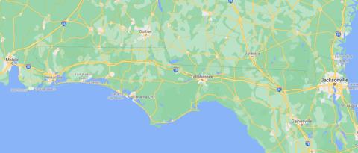
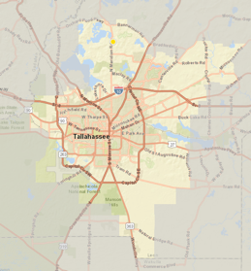
Region 4 – City of Tallahassee
Serves ~102,000 customers in FL
Municipal utility
Used AMI data from 2019
Compared to previous regions:
  Higher % electric heating
Building Type RECS | Saturation
Mobile Home | 7.3%
Multi-Family with 2 - 4 Units | 9.8%
Multi-Family with 5+ Units | 22.6%
Single-Family Attached | 7.5%
Single-Family Detached | 53.0%
Heating Fuel | Heating Fuel
Electricity | 88.5%
Fuel Oil | 0.2%
Natural Gas | 8.2%
Other Fuel | 0.2%
Propane | 2.9%

Slide 49
List of updates
New validation comparisons
Load Research Data from 16 utilities in 2018
Residential monthly EIA electricity sales adjusted for PV generation
Residential monthly EIA electricity sales adjusted for billing periods
AMI data from Electric Power Board of Chattanooga
AMI data from Horry Electric
AMI data from City of Tallahassee
New capabilities
Consistent weather infrastructure with ComStock
California Energy Commission (CEC) Building Climate Zones
Progress towards a correction model
Baseload updates
Increase LED saturation to 2019 levels
Shift baseload schedules by state and month
HVAC updates
Reduce vacant unit heating setpoints
Break out heating setpoints for electric zonal heating
Break out cooling setpoints for room air conditioners
Impact of coastal weather for Horry, SC

Slide 50
Where did we end up?
Calibration improvements and load shape status

Slide 51
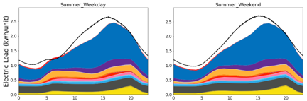
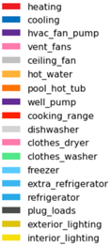
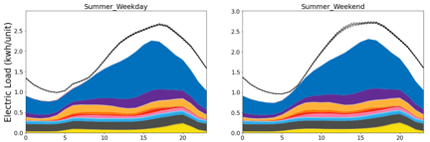
Seasonal end-use loads by day type
EPB, Chattanooga, TN
service territory
Horry Electric
service territory
AMI/LRD uncertainty
AMI average
City of Tallahassee
service territory
LRD uncertainty is 10%
AMI uncertainty is the standard error.
res_national_48_2018
res_epb_scl_tal_48_2019
Hour of day (0-23)
Hour of day (0-23)

Slide 52
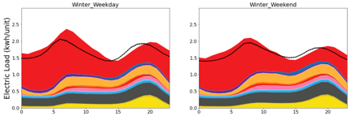
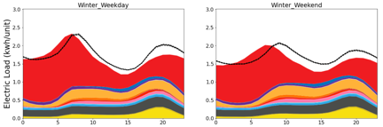
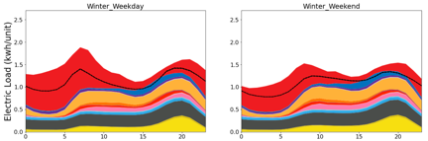
Seasonal end-use loads by day type
EPB, Chattanooga, TN
service territory
Horry Electric
service territory
AMI/LRD uncertainty
AMI average
City of Tallahassee
service territory
LRD uncertainty is 10%
AMI uncertainty is the standard error.
res_national_48_2018
res_epb_scl_tal_48_2019
Hour of day (0-23)
Hour of day (0-23)

Slide 53
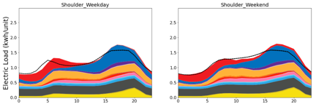
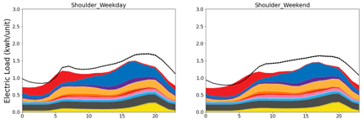
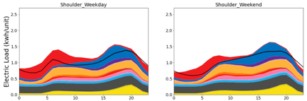
Seasonal end-use loads by day type
EPB, Chattanooga, TN
service territory
Horry Electric
service territory
AMI/LRD uncertainty
AMI average
City of Tallahassee
service territory
LRD uncertainty is 10%
AMI uncertainty is the standard error.
res_national_48_2018
res_epb_scl_tal_48_2019
Hour of day (0-23)
Hour of day (0-23)

Slide 54
Annual Error For Region 4 AMI datasets
EPB, Chattanooga, TN
Horry Electric
Low on annual usage per unit
City of Tallahassee
Region 4
Region 2
Region 3
Region 4
Region 4
High on annual usage per unit
Reasons for discrepancies
Horry: Cooling load too low
Tallahassee: SFD load too high
Only 2019 AMI data is available, so we don’t have QOIs from previous 2018 runs
QOIs calculated for previous 2018 runs
Only 2019 AMI data is available, so we don’t have QOIs from previous 2018 runs

Slide 55


EPB, Chattanooga, TN service territory: shape error metrics
Summer peak timing could be improved
Average of All Days
Top 10 Days
Peak Timing

Slide 56
Horry Electric service territory: shape error metrics
Summer peak could be improved
Average of All Days
Top 10 Days
Peak Timing
Region
2
Region
3
Region
4
Region
2
Region
3
Region
4
Shoulder baseload could be improved

Slide 57
City of Tallahassee service territory: shape error metrics
Average of All Days
Top 10 Days
Peak Timing
Winter peaks could be improved
Winter peaks could be improved

Slide 58
New/updated validation comparisons

Slide 59
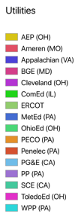
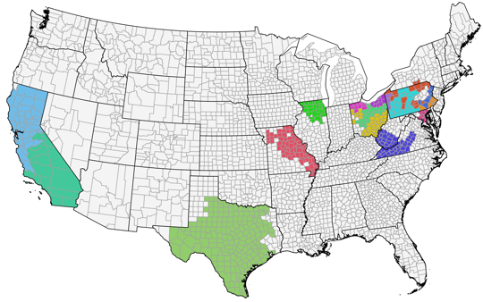
2018 Load Research Data Comparisons
Load research data comparison updated from 2012 to 2018
2018 utility service territory according to EIA Form 861
*Service territories may overlap

Slide 60
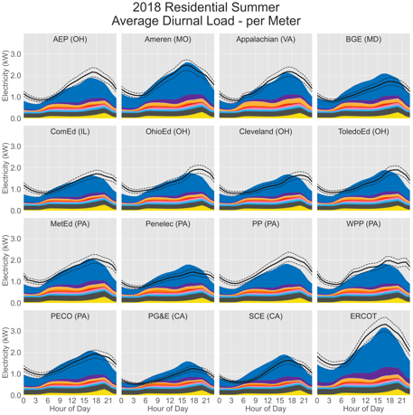
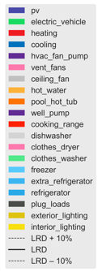
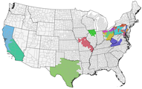
2018 Load Research Data Comparisons
Time shift in some LRD sets
res_national_48_2018

Slide 61
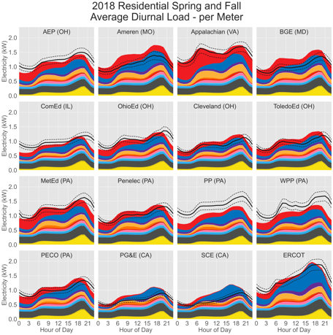
2018 Load Research Data Comparisons
Number of customers may be affecting comparison
Inaccurate customer counts affect comparison
res_national_48_2018

Slide 62
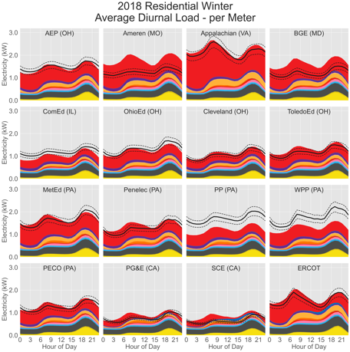
2018 Load Research Data Comparisons
Number of customers may be affecting comparison
Inaccurate customer counts affect comparison
res_national_48_2018

Slide 63
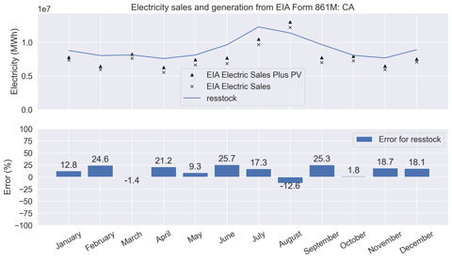
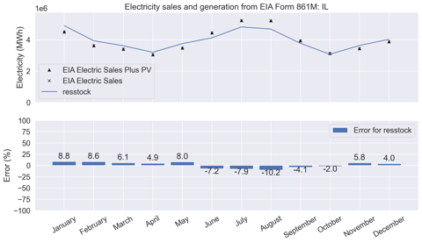
Residential monthly EIA electricity adjusted for PV generation
TAG Feedback: Behind-the-meter PV generation may be non-negligible in some states
Introduced residential small-scale PV generation (EIA Form 861) into monthly comparisons
Significant increase in load especially in summer
Calibration target EIA Electric Sales Plus PV
Most states do not have significant PV generation
res_national_42_2018

Slide 64
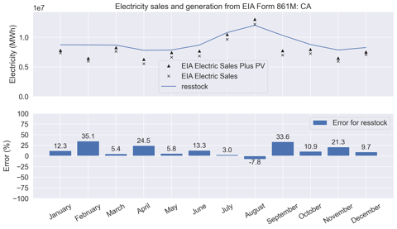
Residential monthly EIA electricity adjusted billing reporting periods
Not all states seem to be affected
TAG member used California as an example for and verified analysis by using CEC data
CA most likely uses billing months
Summer peak shifted
Before weighting function applied
After weighting function applied
res_national_42_2018

Slide 65
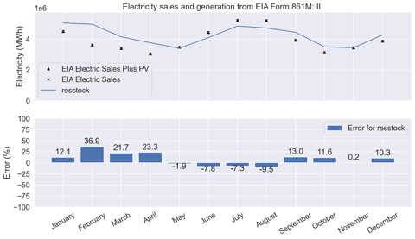
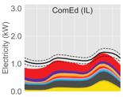
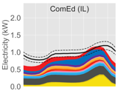
Residential monthly EIA electricity adjusted billing reporting periods
The winter, spring, and fall over prediction seems unlikely when using LRD
The winter, spring, and fall over prediction seems unlikely when using LRD
Not all states seem to be affected
IL most likely uses calendar months
Before weighting function applied
After weighting function applied
Using LRD to verify
Winter
Spring and Fall
Hour of Day
Hour of Day
res_national_42_2018

Slide 66
Residential stock end-use summary
ComEd, IL
City of Fort Collins, CO
Seattle City Light, WA

Slide 67
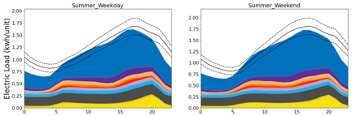
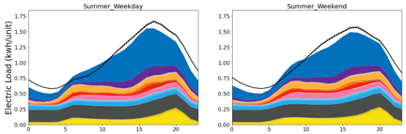
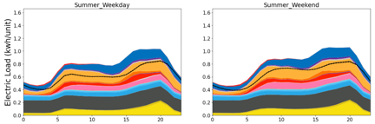
Seasonal end-use loads by day type
ComEd
service territory
City of Fort Collins
service territory
AMI/LRD uncertainty
AMI average
Seattle City Light
service territory
LRD uncertainty is 10%
AMI uncertainty is the standard error.
res_national_48_2018
res_epb_scl_tal_48_2019
Hour of day (0-23)
Hour of day (0-23)

Slide 68
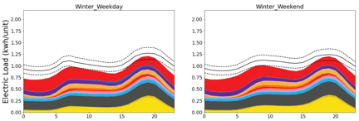
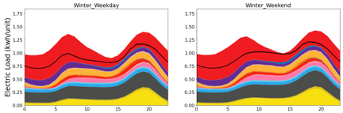
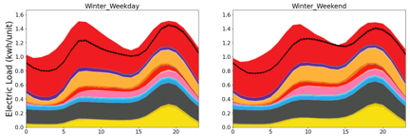
Seasonal end-use loads by day type
ComEd
service territory
City of Fort Collins
service territory
AMI/LRD uncertainty
AMI average
Seattle City Light
service territory
LRD uncertainty is 10%
AMI uncertainty is the standard error.
res_national_48_2018
res_epb_scl_tal_48_2019
Hour of day (0-23)
Hour of day (0-23)

Slide 69
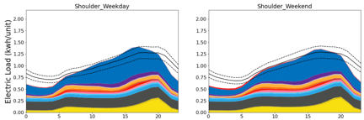
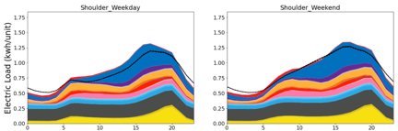
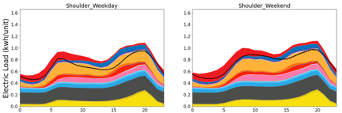
Seasonal end-use loads by day type
ComEd
service territory
City of Fort Collins
service territory
AMI/LRD uncertainty
AMI average
Seattle City Light
service territory
LRD uncertainty is 10%
AMI uncertainty is the standard error.
res_national_48_2018
res_epb_scl_tal_48_2019
Hour of day (0-23)
Hour of day (0-23)

Slide 70
Tracking Quantities of Interest

Slide 71
Annual error: previous calibration regions
ComEd
City of Fort Collins
Seattle City Light
Regional plug load multiplier made ComEd baseload worse
R1
R2
R3
R4
R2
R3
R4
R3
R4
Reasons
Fort Collins and Seattle: Electric heating load too high
ComEd: Low evening and early morning load
R1 = calibration region 1
R2 = calibration region 2
R3 = calibration region 3
R4 = calibration region 4

Slide 72
ComEd service territory: shape error metrics
Average of All Days
Top 10 Days
Peak Timing
R1
R2
R3
R4
R1
R2
R3
R4
Regional plug load multiplier made ComEd baseload worse
Baseload still an issue
Baseload still an issue
R1 = calibration region 1
R2 = calibration region 2
R3 = calibration region 3
R4 = calibration region 4

Slide 73
City of Fort Collins service territory: shape error metrics
Average of All Days
Top 10 Days
Peak Timing
R2
R3
R4
R2
R3
R4
R2 = calibration region 2
R3 = calibration region 3
R4 = calibration region 4
Winter peaks are too high
Winter peaks are too high
Roughly equal peaks causing timing issue

Slide 74
Seattle City Light service territory: shape error metrics
Average of All Days
Top 10 Days
Peak Timing
R3
R4
R3
R4
R3 = calibration region 3
R4 = calibration region 4
Winter peak timing could be improved

Slide 75
Added Capabilities

Slide 76
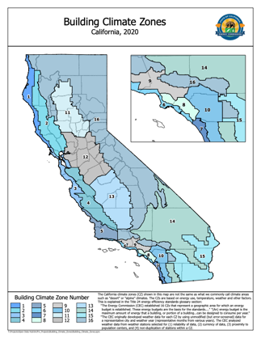
California Energy Commission (CEC) Building Climate Zones
Plan on using CEC building climate zones in final aggregations
Process to produce mapping
  CEC supplies building climate zones by zip code
  Uses U.S. Census zip code to census tract crosswalk to produce mapping
  Census tracts are mapped to PUMAs (many-to-one)
  Result is a file mapping PUMAs (265 PUMAs in CA) to CEC climate zones
Moving forward, samples in California will have a CEC climate zone assigned
https://cecgis-caenergy.opendata.arcgis.com/datasets/eaf3158767674e6cb14f4407186d3607

Slide 77
Correction model: Motivation
Model does not capture all behavior
  Ex: RECS does not capture seasonal changes in setpoints
  Ex: Mean radiant temperature causes setpoints to change during heat waves
Best available data may not accurately capture all aspects of building stock
  Ex: Best available data could over or underpredict appliance saturations, age/efficiency, setpoints, etc.
Rather than trying to tune model inputs without supporting data, we can apply an output correction model to improve fit on a monthly/daily basis

Slide 78
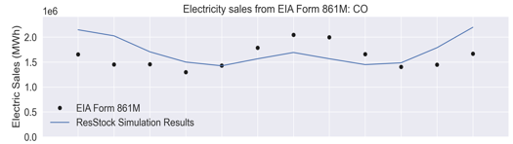
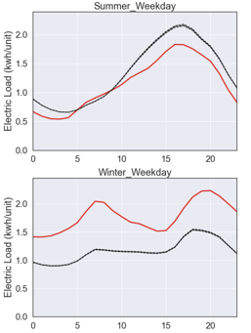
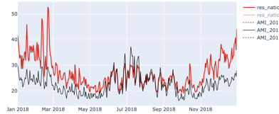
Example: model discrepancies across timescales
Monthly
Hourly
City of Fort Collins Total Residential Stock
Average of Top 10 Load Days
Daily
Consistent under-prediction of cooling and over- prediction of heating across timescales and data sources
Fort Collins Total Residential Stock: Daily Electric Load
kwh/unit
ResStock
AMI Data
Hour of day

Slide 79
Example approaches
Goal is to correct bulk errors but not overfit
Correction to EIA state and monthly data
Adjust all end-uses
Adjust only HVAC loads
…
Approach will evolve until calibration is finished
Suggests that discrepancies are combination of baseload and HVAC loads
Suggests that discrepancies are mostly HVAC loads

Slide 80
Example model formulation
Do not model Alaska and Hawaii, but do model DC
Planning on using multiplicative factors
If use state and month factors, then calculate 588 (49x12) factors, which scale monthly magnitudes but don’t change end use load shapes
Model 1: all end-uses
Model 2: only HVAC end-uses
Corrected end-use energy
Simulated end-use energy
$$s∈\left\{AL,AZ,AR, …, WI,WY\right\}$$
$${\tilde{e}}_{sm}\left(t\right)=α_{sm}e_{sm}\left(t\right)$$
$$m∈\left\{Jan, …, Dec\right\}$$
State and month correction factor

Slide 81
Example model formulation
Multiply all loads by 0.87 to match EIA Form 861
Multiply HVAC loads by 0.6 to match EIA Form 861
Multiply all loads by 0.87 to match EIA Form 861
Example calculation and scaling of results
Simulation output from ResStock
Baseloads are the same

Slide 82


Example impacts of the potential correction models
Fort Collins Total Residential Stock: Daily Electric Load
Improvement in cooling season, but needs work
Uncorrected
Model 1 (All loads)
Model 2 (HVAC only)
AMI Data
kwh/unit
Significant improvement in heating season

Slide 83


Example impacts of the potential correction models
Fort Collins Total Residential Stock
Average of top 10 load days
Season average load
Overcorrection in summer suggests a model that uses degree days to apply the monthly correction could improve the fit
Model 2’s better match suggests errors are HVAC related
Uncorrected
Model 1 (All loads)
Model 2 (HVAC only)
AMI Data
Hour of day
Hour of day

Slide 84
Baseload Updates

Slide 85
Update: LED saturation
Before: LED saturation near 2015 levels with regional diversity
After: LED saturation at 2019 levels while maintaining regional diversity
Comparison of national average lighting saturation to previous ResStock data sources →
Increased LED saturation
ResStock is now a combination of RECS 2015 for regional diversity, but the LED saturations are adjusted to match forecasted 2019 levels

Slide 86




Impact: LED saturation
Total Stock: Tallahassee, FL
Largest difference (but still minor) seen in Northwest
Not significant impact for the Southeast
Not significant impact for the Southeast
Total Stock: Seattle, WA
Total Stock: Chattanooga Service Territory
After
Before
AMI uncertainty (standard error)
AMI average

Slide 87






Update: Baseload schedule shifting using
American Time Use Survey (ATUS)
Investigated urban vs. rural schedule differences
No significant difference in schedules between MSA and non-MSAs
Metro: All counties belonging to an MSA in the U.S.
Non-Metro: All counties not belonging to an MSA in the U.S.

Slide 88



Update: Baseload schedule shifting using
American Time Use Survey (ATUS)
Investigated urban vs. rural schedule differences
  Manhattan vs. New York state outside of New York City
Downtown areas may have different schedule than the rest of the MSA
MSAs are counties or multiple counties which may dilute behavior with suburban or even rural areas
Low samples sizes in ATUS makes other activity comparisons difficult
Manhattan sleeps ~30 min later
Manhattan sleeps ~30 min later
Manhattan stays out ~1-1.5 hours later

Slide 89





Update: Baseload schedule shifting using
American Time Use Survey (ATUS)
State and month schedule lead/lags from national average
Calculated cross-correlation with the national average schedule
Average weekday baseload shift
Maximum weekday baseload shift
* All shifts are relative to the national average baseload schedule
* Positive shift (forward in time), negative shift (backward in time)

Slide 90



Impact: Baseload schedule shifting using
American Time Use Survey (ATUS)
EPB, Chattanooga, TN
Horry Electric
City of Tallahassee
After baseload shifts
Before change
AMI uncertainty (standard error)
AMI average
Little impact due to most shifts being less than 30 min
Minor shape improvements
Minor shape improvements

Slide 91
HVAC Updates

Slide 92

Update: Vacant Unit Heating Setpoints
Vacant units are empty
Heating is largest modeled electric load for vacant units
New Assumption
  Reduce vacant unit heating setpoints to 55 °F
  Approach is “don't freeze the pipes” instead of using occupied setpoints.

Slide 93



Impact: Vacant Unit Heating Setpoints
Reduced vacant unit setpoints
Baseline
AMI uncertainty (standard error)
AMI average
EPB
EPB
Largest difference in Horry
Decrease in all regions
Decrease in all regions
Decrease in all regions
Horry
Horry
Tallahassee
Tallahassee

Slide 94

Update: Zonal Electric Heating Setpoints
NEEA’s 2011 Residential Building Stock Assessment has evidence that homes with baseboard or plug-in electric heaters use less heating energy than homes with electric furnaces.
This could be explained by lack of duct losses for baseboard/plug-in heating, but modeling in the region has overpredicted baseboard/plug-in heating, which suggests a different cause, such as “zonal” temperature control in different rooms.
Source: “SEEM RBSA Calibration, Phase II – Electric Heating Energy Adjustments due to Supplemental Heat, Program Eligibility, and Related Factors.” RTF Staff Technical Report. 2013. https://nwcouncil.app.box.com/s/51k80odysyf5hmpd6g9swr7g6y0cvxsv

Slide 95
Update: Zonal Electric Heating Setpoints
We found that RECS 2009 data on heating setpoints for zonal electric heating are lower on average than ducted electric furnaces/heat pumps
2A, 3A, and 4A are the IECC climate zones corresponding to Tallahassee, Horry, and Chattanooga

Slide 96

Update: Zonal Electric Heating Setpoints
We added a dependency on zonal electric heating to our heating setpoint and setback distributions queried from RECS 2009.
Base at-home heating setpoint distribution

Slide 97



Impact: Zonal Baseboard Heating Setpoints
Some locations are slightly worse, but minor impact
Total Stock
EPB, Chattanooga, TN
Minor impact may be due to higher central setpoints with lower baseboard setpoints
Total Stock
Horry Electric
After change
Total Stock
Tallahassee, FL
Before change
AMI uncertainty (standard error)
AMI average

Slide 98

Update: Room AC Cooling Setpoints
California’s 2009 Residential Appliance Saturation Study (RASS) breaks out Room AC setpoints from other cooling types
Non-room AC systems have approximately the same setpoints
ResStock now accounts for lower room AC setpoints
Integrating lower room AC setpoints in ResStock
Cooling Setpoint (9am – 5pm): RASS 2009
Main HVAC System Cooling Type | <70F | 70F-73F | 74F-76F | 77F-80F | >80F
Central AC | 8.0% | 19.0% | 25.5% | 36.4% | 11.1%
Evaporative Cooler | 13.2% | 16.5% | 25.9% | 35.1% | 9.2%
Heat Pump | 11.6% | 29.2% | 20.4% | 33.4% | 5.4%
Room AC | 41.4% | 53.0% | 4.4% | 1.3% | 0.0%
Room AC setpoints ~6F cooler than other systems

Slide 99






Impact: Room AC Cooling Setpoints
Larger impact in ComEd and City of Fort Collins
Larger impact in ComEd and City of Fort Collins
Total Stock
EPB, Chattanooga, TN
Total Stock
ComEd, IL
Total Stock
Horry Electric, SC
Total Stock
City of Fort Collins, CO
Little change in Southeast due to high saturation of central AC systems
Little change in Southeast due to high saturation of central AC systems
Little change in Southeast due to high saturation of central AC systems
Total Stock
Tallahassee, FL
Total Stock
Seattle City Light, WA
Hour of day (0-23)
Hour of day (0-23)

Slide 100
Areas for Improvement

Slide 101
Next Region: Likely Areas for Improvement
Changes underway
Continue improving correction model
Improve data on multifamily building heights
Improve data source for masonry vs. wood framed walls (esp. important for Northeast)
Incorporate on-site PV generation in models
Potential areas for Region 5 (may not get to all items on list)
Introduce partial space heating to reduce electric heating loads
Incorporate saturation of existing ductless heat pumps (esp. important for Northeast)
Improve data source for duct leakage
Improve geographic resolution for 1980s-2000s insulation data
Investigate how setpoints change seasonally (using Ecobee data)

Slide 102
Conclusions
Ran 12 iterations of ResStock incorporating 10 discrete changes
  Saw general improvements in QOI metrics​
  Most of the improvements made will carry over to the entire U.S.​
  New 2018 LRD comparison shows that we’ve made substantial improvements in regions outside of our AMI calibration regions
New/Updated visualizations
  Increase EIA monthly loads using PV generation data
  Correct for reporting errors in EIA monthly data
  2018 LRD data comparisons
  AMI data from City of Tallahassee
  AMI data from EPB, Chattanooga, TN
  AMI data from Horry Electric
Priority areas for improvement for next region
  Reducing electric heating loads
  Continue improving correction model
  Improve data source for masonry vs. wood framed walls (esp. important for Northeast)
  Incorporate saturation of existing ductless heat pumps (esp. important for Northeast)
Will be moving on to Regional Dataset 5 (Vermont; Maine; Cherryland, MI), but continue tracking metrics for the first four region datasets

Slide 103
Residential Poll Questions

Slide 104

Breakout group #1: Selecting your breakout room
Room 1: Deep dive on residential calibration. In this breakout session we will answer questions that members have on our residential calibration. We can discuss questions pertaining to the results from our fourth residential region, past calibration results or other aspects of our residential calibration process.
Room 2. Project recap. Members of the End Use Load Profile team will provide an overview of the project, our work to date and our final load profiles and models. We are offering this breakout group for members who have not been in the Technical Advisory Group for the entire project or anyone who would like a refresher on the project status and goals.
Breakout rooms will be recorded.

Slide 105
End-Use Load Profiles for the U.S. Building Stock: Project Recap
Eric Wilson
April 21, 2021

Slide 106

What is an End-Use Load Profile?
End-use load profiles…
describe how and when energy is used
End-use load/savings profiles are…
the most essential data resource currently missing for Time-Sensitive Valuation of Energy Efficiency
needed for R&D prioritization, utility resource and distribution system planning, state and local energy planning and regulation
critical for widespread adoption of
grid-interactive and efficient buildings.
Source: Navigant Massachusetts RES 1 Baseline Load Shape Study
Notes:
Existing profiles are limited in terms of the frequency with which they’re updates, which regions they’re available in, and how much of the building stock they cover

Slide 107





Challenge & Opportunity
Challenge
Existing end-use load profiles are often outdated and limited to certain regions and building types because of the high cost of traditional end-use sub-metering.
They are insufficient for accurate evaluation of numerous emerging use cases of grid-interactive and efficient buildings.
Opportunity
New ResStockTM and ComStockTM models statistically represent energy use of U.S. buildings.
Models produce hourly end-use load profiles, but prior calibration efforts focused on annual energy use.
Source: Navigant
Notes:
Existing profiles are often outdated, regionally limited, based on small sample size, and limited to a subset of the building stock because of the high cost of the historical sub-metering approach.
https://www.istockphoto.com/photo/engineer-to-use-digital-clip-ampere-meter-clamp-to-power-cable-gm950050388-259318489
https://www.istockphoto.com/photo/smart-grid-conceptual-abstract-gm612623042-105558603

Slide 108
Solution: A Hybrid Approach (1)
Hybrid approach combines
best-available ground-truth data—
submetering studies,
whole-building interval meter data, and
other emerging data sources
—with the reach, cost-effectiveness, and granularity of physics-based and data-driven building stock modeling capabilities
The novel approach delivers a nationally-comprehensive dataset at a fraction of the historical cost.
Notes:
[Eric]
- stochastic
- validation, UQ
-
we have large budget but not enough to do submetering everywhere.
Mention NEEA cost of $10mil just for PNW

Slide 109


Project Outcomes | Calibrated Building Stock Models
+
+
Building stock characteristics database
Physics-based
computer modeling
High-performance computing
DOE-funded, NREL-developed models of the U.S. building stock
100,000s of statistically representative physics-based building energy models (BEM)
Use DOE’s BEM tools OpenStudio and EnergyPlus
Produce hourly load profiles, but calibration to-date has focused on annual energy consumption

Slide 110
Project Outcomes | Working List of End Uses
Commercial
HVAC
Service water heating
Residential
HVAC
Domestic water heating
Heating
Cooling
Fans
Pumps
Heat rejection
Humidification
Heat recovery
Refrigeration
Plug and process loads
Lighting
Interior
Exterior
Heating
Cooling
Furnace/Air-conditioning
Boiler pumps
Ventilation fans
Major appliances
Refrigerator
Clothes washer
Clothes dryer
Dishwasher
Cooking range
Pool/spa pumps & heaters
Miscellaneous plug loads
Lighting
Interior
Exterior

Slide 111
Project Outcomes | Working List of Building Types
Commercial
Small Office
Residential
Single-Family Detached
Medium Office
Large Office
Stand-alone Retail
Strip Mall
Primary School
Secondary School
Outpatient Healthcare
Hospital
Small Hotel
Large Hotel
Warehouse (non-ref.)
Quick Service Restaurant
Full Service Restaurant
Supermarket
Single-Family Attached
Multifamily low-rise
Multifamily mid-rise
Multifamily high-rise

Slide 112
Project Outcomes| Aggregate and Individual Load Profiles
Example aggregate versus individual EULP concept demonstration using water draws

Slide 113





Project Team
Northeast Energy Efficiency Partnerships

Slide 114













































Stakeholder Engagement
In-kind participation by 65 advisory group members

Slide 115
Project Timeline
FY19 (ends 9/30/2019)
FY20 (ends 9/30/2020)
FY21 (ends 9/30/2021)
Beyond
Technical Advisory Group
You are here
Com: 2 of 4 calibration regions complete
Res: 4 of 5 calibration regions complete
Define use cases and requirements
Collect/review existing data
Report on market needs and data gaps
Targeted data acquisition leveraging planned/ongoing sub-metering studies
Data analysis to derive occupant-driven schedules and usage diversity
Rigorous calibration of building stock end-use models
Quantify accuracy of results for target applications
Calibrated
building stock models
EE/DR savings profiles
Stochastic occupancy modeling capabilities
Load profile library,
documentation, & user guide
Ongoing additions to load profile library
Notes:
We are moving right along in our project timeline. We are already in our second quarter of our fiscal quarter for this project. We anticipate that the final load profiles and models will be available in September of this year, along with model documentation and a user guide.

Slide 116
Market Needs and Use Cases

Slide 117

Year One Report is Available
End Use Load Profiles for the U.S. Building Stock: Market Needs, Use Cases and Data Gaps is available now
Notes:
[Eric]

Slide 118

Market Needs | Existing Publicly Available End Use Load Profiles
We developed an inventory of publicly available end-use load profiles.
The inventory is now available on LBNL’s website: https://emp.lbl.gov/publications/end-use-load-profile-inventory
States with Publicly Available End-Use Load Profile Data*
*There are significant differences in the number of load profiles available in each state. See the inventory for more detail.

Slide 119
Market Needs| Use Case Identification
Use cases: type of process or analysis that utilize end-use load profiles
The project team and technical advisory group brainstormed and prioritized use cases
10 most mentioned use cases are presented in the report
  Electricity Resource Planning
  Energy Efficiency Planning
  Policy and Rate Design
  Transmission and Distribution System Planning
  Program Impact Evaluation
  Demand-Response Planning
  Improved Building Energy Modeling
  Electrification Planning
  Emissions Analysis
  PV Planning
Use cases informed data requirements for modeling

Slide 120
Use Cases | Data Fidelity Requirements
Use Case Data Requirements
Use Case | Time Resolution | Geographic Resolution | Electrical Characteristics
Electricity Resource Planning | Hourly or peak day | Service territory | Real power
Energy Efficiency Planning | Hourly or peak day | Service territory | Real power
Policy and Rate Design | 15 min to hourly | City, climate zone, or state | Depends on application
Transmission and Distribution System Planning | 15 min or smaller | Distribution feeder | Real and reactive power
Program Impact Evaluation | Hourly | Service territory | Real power
Demand-Response Planning | 15 min to hourly | Service territory | Real power
Improved Building Energy Modeling | 15 min | Region | Real power
Electrification Planning | Hourly | Service territory or smaller | Real power
Emissions Analysis | Hourly | Service territory or larger | Real power
PV Planning | 1 min | Weather station | Real power
Notes:
Use cases: type of process or analysis that utilize end-use load profiles
Ten most mentioned use cases are presented in the report
Use cases informed data requirements for modeling

Slide 121
Use Cases | Data Fidelity Requirements
Time Resolution
Geographic Resolution
Utility territory
County
Distribution System Planning requires feeder-level data
Electrical Characteristics
PV Planning is the only top use case that requires less than 15-minute data
A “mix-and-match” approach from a bank of load profiles could help build specific utility and feeder level information
Real power
Some distribution system planning use cases might benefit from reactive power
15-minute
Highest impact cases require only hourly results
Data requirements for some use cases are not well understood

Slide 122
Data Needs and Identified Gaps
Notes:
[Natalie]

Slide 123





How are we using data?
Timeseries Data
(end-use, whole-building, sector)
Input Data
(non-timeseries
characteristics,
weather)
Extract schedules, diversity
Comparison
Inputs
Outputs
100,000s of virtual buildings
Calibration feedback informs updates to inputs

Slide 124
Model Calibration Data
Summary of Calibration Data Classes
Type of Calibration Data | Summary of Availability
Utility Sales: Annual sales/consumption data by sector by utility | Universally available from U.S. Energy Information Administration (EIA)
Load research data: Utility customer class aggregate load shapes | Acquired for ~20 utility companies and the Electric Reliability Council of Texas
Advanced metering infrastructure (AMI): Whole-building AMI data joined with building characteristic metadata | Acquiring in multiple census divisions, via nondisclosure agreements with utility companies
Submetered: End-use metering data, including smart thermostat data | Multiple (3+) strong data sets available for residential; few data sets available for commercial buildings

Slide 125
Addressing Data Gaps
From the initial data collection, the largest identified gap was submetered data for commercial buildings
To address this gap, we:
Conducted a targeted market research effort to identify data sets for potential purchase (BAS data, EM&V studies, etc.)
Are studying transferability between building types and regions

Slide 126
Commercial End-Use Data Procurement
Summary
  Major outreach effort, >700 hours
  10 datasets purchased
https://www.nrel.gov/docs/fy20osti/77102.pdf
Notes:
Commercial submeter data:
Conducted targeted outreach
Talked to 50 companies
Looks like we will be able to get reasonable coverage, currently procuring data
Expecting a range of data quality
Go/no-go end of February

Slide 127
Sample Sizes: Weather-driven End Uses
Weather-driven | Proposed Minimum Sample Size¹ | Oct 31st Package Sample Size² | Procured Sample Size³
Heating | 48 | 6218 | 5176
Cooling | 48 | 6598 | 5351
Fans | 21 | 2497 | 328
Pumps | 21 | 500 | 83
Heat Rejection | 21 | 21 | 41
Humidification | 21 | 27 | 22
Heat Recovery | 21 | 22 | 36
Refrigeration | 21 | 1076 | 1010
Exterior Lighting | 21 | 846 | 846
No gaps identified
¹Minimum sample size targets presented at subject matter expert webinar on 8/28/2019.
²Counts based on vendor rough estimates obtained during market outreach
³Procured Sample Size includes data in hand and data that is being contracted for procurement
Notes:
These are minimums
Across all regions and building types (similar to CEMS)
More samples for heating and cooling to cover different system component types (e.g. elec res vs. heat pump)
Sample size is not only driver of accuracy—just one of several tiers/strategies.

Slide 128
Sample Sizes: Schedule-driven End Uses
Schedule-driven |  | Hospital | Outpatient | Primary School | Secondary School | Full-Service Restaurant | Quick Service Restaurant | Retail | Strip Mall | Supermarket | Small Hotel | Large Hotel | Warehouse | Multifamily | Small Office | Medium Office | Large Office
Proposed Minimum Sample Size¹ | Interior Lighting | 21 |  | 21 |  | 21 |  | 21 |  | 21 | 21 |  | 21 | n/a | 21
 | Interior Equipment | 21 |  | 21 |  | 21 |  | 21 |  | 21 | 21 |  | 21 | n/a | 21
 | Service Water Heating | 0 |  | 0 |  | 0 |  | 0 |  | 0 | 0 |  | 0 | n/a | 0
 | Cooking | n/a |  | n/a |  | n/a |  | n/a |  | n/a | n/a |  | n/a | n/a | n/a
Oct 31st Package Sample Size² | Interior Lighting | 103 |  | 281 |  | 760 |  | 1046 |  | 137 | 53 |  | 270 | 20 | 337
 | Interior Equipment | 2 |  | 285 |  | 196 |  | 214 |  | 4 | 5 |  | 25 | 22 | 270
 | Service Water Heating | 0 |  | 0 |  | 316 |  | 106 |  | 0 | 0 |  | 0 | 0 | 1
 | Cooking | 0 |  | 2 |  | 2618 |  | 0 |  | 0 | 1 |  | 0 | 0 | 0
Procured Sample Size³ | Interior Lighting | 76 |  | 162 |  | 710 |  | 800 |  | 71 | 42 |  | 131 | 65 | 118
 | Interior Equipment | 4 |  | 284 |  | 200 |  | 196 |  | 3 | 2 |  | 50 | 367 | 53
 | Service Water Heating | 0 |  | 0 |  | 317 |  | 107 |  | 1 | 0 |  | 15 | 98 | 1
 | Cooking | 0 |  | 0 |  | 2620 |  | 1 |  | 1 | 0 |  | 0 | 0 | 0
¹Minimum sample size targets presented at subject matter expert webinar on 8/28/2019.
²Counts based on vendor rough estimates obtained during market outreach
³Procured Sample Size includes data in hand and data that is being contracted for procurement
=gap
Notes:
These are minimums
Sample size is not only driver of accuracy—just one of several tiers/strategies.
CBECS shows very small electricity usage for SWH, so we propose minimums of zero (though we will get some data).
Hypothesize that these transfer across regions (as proposed in KEMA 2009)
AMI data can be used to derive differences in operating hours.

Slide 129




Commercial Calibration Dimensions
Annual and monthly electricity and natural gas consumption by state, sector
Com. Calibration
EIA 861m electricity, natural gas
EIA CBECS
Utility load research data (LRD)
Region 1 AMI data
Region 2 AMI data
Region 3 AMI data
Region 4 AMI data
Submetered end-uses
AMI data from (likely)
Horry County, SC;
Chatanooga TN;
Tallahassee, FL
Annual gas and electricity EUIs by building type
AMI data from Vermont; Maine; Cherryland, MI
Sub-metered end-use load data
(10 datasets)
AMI data (aggregated by building type) from
Seattle City Light, WA and Portland General Electric, OR
Load duration curves and seasonal load shapes of ~16 utilities around U.S.
AMI data from Fort Collins municipal service territory (CO)

Slide 130

Residential Calibration Dimensions
Res. Calibration
EIA Form 861
EIA 861m electricity, natural gas data
EIA RECS
modeled end-uses
Utility load research data (LRD)
Region 1 AMI data
Region 2 AMI data
Region 3 AMI data
Region 4 AMI data
Region 5 AMI data
Submeter end-uses
Annual electric sales of all utilities in U.S.
AMI data from Vermont; Cherryland, MI
Annual and monthly electricity and natural gas consumption by state, sector
AMI data from Electric Power Board of Chattanooga, TN
Horry Electric (SC), and City of Tallahassee, FL
Annual end-use loads of occupied dwelling units
Building type
Climate zone
Fuel (electricity, natural gas, propane, fuel oil)
AMI data (aggregated by building type) from
Seattle City Light, WA
Sub-metered end-use load data (5 datasets)
AMI data from Fort Collins municipal service territory (CO)
Load duration curves and seasonal load shapes of ~16 utilities around U.S.
Advanced metering infrastructure (AMI) data from ComEd service territory (IL)

Slide 131
Uncertainty quantification framework
Notes:
[Natalie]

Slide 132
“Quantities of Interest” = Key Model Outputs
Quantities to be primary focus for calibration
Outputs that will contain uncertainty bounds

Slide 133
Quantities of Interest (QOI)
by building type and region
Annual energy use (MWh)
Average daily minimum magnitude (MW)
  Summer, All days
  Winter, All days
  Shoulder, All days
Average daily maximum magnitude (MW)
  Summer, All days
  Summer, Top 10 days
  Winter, All days
  Winter, Top 10 days
  Shoulder, All days
Hour of day (0-23)
Average daily maximum load timing (hour of day)
  Summer, All days
  Summer, Top 10 days
  Winter, All days
  Winter, Top 10 days
  Shoulder, All days

Slide 134






Sensitivity Analyses
Ranking of Critical EnergyPlus Inputs
Ranking of ResStock / ComStock Inputs
LA
Chicago
X17 | InternalLoad_PlugLoad
X12 | InternalLoad_Lights
X1 | Fabric_Absorptance
X6 | Fabric_InfiltrationFlowCoef
X8 | Fabric_InternalMassMultiplier
X19 | Site_GroundReflectance
X2 | Fabric_Conductivity
X21 | System_DXCoilCoolingCOP
X10 | Fabric_WindowSHGC
X26 | System_FanTotalEfficiency
X25 | System_FanPressureRise
X15 | InternalLoad_People
X17 | InternalLoad_PlugLoad
X12 | InternalLoad_Lights
X6 | Fabric_InfiltrationFlowCoef
X1 | Fabric_Absorptance
X21 | System_DXCoilCoolingCOP
X19 | Site_GroundReflectance
X28 | System_FanTotalEfficiency
X27 | System_FanPressureRise
X2 | Fabric_Conductivity
Stock average: 33.34GJ
Stock average: 100.00GJ
Miami
X17 | InternalLoad_PlugLoad
X12 | InternalLoad_Lights
X21 | System_DXCoilCoolingCOP
X6 | Fabric_InfiltrationFlowCoef
X1 | Fabric_Absorptance
X19 | Site_GroundReflectance
X27 | System_FanPressureRise
X28 | System_FanTotalEfficiency
X15 | InternalLoad_People
Stock average: 162.09GJ

Slide 135
Uncertainty Quantification (UQ)
Peak day
cooling load shape
Without UQ
Percent of homes with AC (in specific county/vintage): 50%
Peak =
4 MW
Run
Model
Other inputs
Model
Peak =
3.7–4.2 MW
Percent of homes with AC: 40%, 43%, 50%, 56%, 59%
Model
Model
Model
With UQ
Run
Model
Other inputs
The uncertainty range is propagated through the model to determine uncertainty of outputs
Notes:
would make it clear that we are using best available data and that our inputs do vary appropriately based on that data, and then how we define the UQ range that we input?

Slide 136
Residential end-use transferability study

Slide 137
Residential end use transferability
Question: Are residential end use patterns the same across regions?
Navigant Massachusetts Residential Baseline Study (Mass Res 1)
  356 sites, metered between May 2017 and April 2018
  Massachusetts, representative sample
NEEA Residential Building Stock Assessment: Metering Study (RBSAM)
  101 homes, metered from 2012-04-01 to 2014-07-31
  Pacific Northwest, representative sample
Florida Solar Energy Center - Phased Deep Retrofit Study (FSEC)
  56 homes, metered from 2012 to 2016
  Central Florida, biased sample
Pecan Street Dataport (Pecan Street)
  998 homes, metered between 2011 to 2014
  Texas (97%), biased sample
American Time Use Survey (ATUS)
  ~55,000 respondents from 2013–2017 (one day of activities per respondent)
  National, representative sample
Notes:
[Eric]

Slide 138




Comparing ATUS to end-use datasets

Slide 139
New Residential Stochastic Occupant Behavior Model

Slide 140
Summary of Changes
 | 2019 Status |  | March 2020 Status |  | Type | Data sources
Activity | Schedule Heterogeneity | Schedule Stochasticity | Schedule Heterogeneity | Schedule Stochasticity | Occupants/Household | Start time | Duration | Magnitude (Power, Flow)
Occupant (heat gain) | No | No | Yes | Yes | Occupants | ATUS | ATUS | ATUS
Sinks HW | Yes* | Yes* | Yes | Yes | Household | DHWESG | DHWESG | DHWESG
Showers/Baths HW | Yes* | Yes* | Yes | Yes | Occupants | ATUS | DHWESG | DHWESG
Dishwasher HW | Yes* | Yes* | Yes | Yes | Occupants | ATUS | ATUS | DHWESG
Dishwasher kW | Yes* | Yes* | Yes | Yes | Occupants | ATUS | ATUS | End-use datasets
Clothes Washer HW | Yes* | Yes* | Yes | Yes | Occupants | ATUS | End-use datasets | DHWESG
Clothes Washer kW | Yes* | Yes* | Yes | Yes | Occupants | ATUS | DHWESG | End-use datasets
Clothes Dryer kW | Yes* | Yes* | Yes | Yes | Occupants | ATUS | End-use datasets | End-use datasets
Cooking Range | No | No | Yes | Yes | Occupants | ATUS | ATUS | End-use datasets
Misc. Electric Loads | No | No | Yes | Yes* | Household | Modify avg. schedule based on occupancy
Lighting | No | No | Yes | Yes* | Household | Modify avg. schedule based on occupancy
Thermostat setpoints | No | No | Yes | No | Household | RECS, ecobee
Bath exhaust fan | No | No | Yes | No | Household | Modify schedule based on occupancy
Kitchen exhaust fan | No | No | Yes | No | Household | Modify schedule based on occupancy
* = Some degree of heterogeneity or stochasticity, but could be improved
ATUS = American Time Use Survey
DHWESG = NREL Domestic Hot Water Event Schedule Generator (based on data from the American Water Works Association)
End-use datasets = Pecan St., RBSAM, FSEC, etc.

Slide 141
1 home
Typical week
Occupancy now changes day to day
Plug loads and lighting are lower when occupants are away or sleeping
Previously, cooking range was identical day-to-day

Slide 142
1000 homes
Typical week
10-minute resolution
Previously, using subhourly resolution exacerbated spikiness dramatically, due to insufficient diversity

Slide 143
Questions?
https://www.nrel.gov/buildings/end-use-load-profiles.html

Slide 144
Break 11:45 -11:50 MT
Please rejoin us at 11:50 MT to participate in breakout group #2

Slide 145
Breakout group #2: Selecting your breakout room
Room 1: A method for developing general load profiles for industry. There are no publicly-available data sources that adequately capture the variability of energy load profiles across industries. In this breakout, NREL researcher Colin McMillan will describe a method for generating general load profiles using public data on weekly, seasonal, and other operational characteristics of industry.
Room 2: Cambium: a public dataset of hourly marginal carbon emissions and avoided cost metrics for the electric sector through 2050. During this breakout, NREL researcher Pieter Gagnon will introduce Cambium, a newly released data product from NREL that contains highly detailed projections of the electric grid through 2050, including cost, emission, and operational metrics that are specifically designed to be useful for supporting demand-side decision-making and research.
Breakout rooms will be recorded.

Slide 146

Cambium
Public database of hourly emissions, costs, and operations for the electric sector through 2050
Pieter Gagnon (Pieter.Gagnon@nrel.gov) – National Renewable Energy Laboratory
April 21st, 2021

Slide 147
Agenda
Brief overview & context
Emission metrics
Cost metrics
Open discussion
Open discussion

Slide 148

The Standard Scenarios
Annually updated set of electric sector projections

Slide 149
The models
ReEDS
Projects the evolution of the electric grid through 2050
PLEXOS
Simulates the hourly operation of future grids
Cambium
Calculates new metrics; builds the database
Cambium database
Hourly through 2050
Operational metrics
Cost metrics
Emission metrics

Slide 150
What’s the point?
1) The grid is changing
2) Some planning metrics are forward-looking
3) Diurnal patterns are increasingly important
4) Brings consistency across forward-looking analyses, for fair comparisons of different technologies

Slide 151
Metrics
Load
Busbar load
Busbar load for end-use
End-use load
Load from storage charging
Transmission losses
Net load
Transmission
Imports
Exports
Operations
Average distribution loss rate
Marginal distribution loss rate
Operating reserve demand
Operating reserve shadow price
Planning reserve margin
Planning capacity
Capacity shadow price
Marginal generator technology
Marginal energy source technology
Solar curtailment
Wind curtailment
Generation
Hourly generation by technology
Capacity
Nameplate capacity by technology
MWh of storage
Portfolio
RPS and CES shadow prices
RPS and CES fractions
Marginal Costs
Energy cost
Capacity cost
Portfolio cost
Operating reserve cost
CO2 Emissions
Average from in-region generation
Average induced by in-region load
Short-run marginal emission rate
Long-run marginal emission rate
Total CO2 emissions

Slide 152

Scenario Viewer and Data Downloader
https://cambium.nrel.gov/

Slide 153
CO2 Emission Metrics

Slide 154
CO2 Emission Metrics
Total Emissions
Total CO2 emissions from in-region generation
Average Rates
Average emission rate of in-region generation
Average emission rate attributed to in-region load
Marginal Rates
Short-run marginal emission rate
Long-run marginal emission rate

Slide 155
Marginal emission rate
The rate that emissions are induced/avoided by a change in electrical load
Two components: operational and structural
Short-run marginal emission rate
Only operational
Long-run marginal emission rate
Both operational and structural
(the long-run marginal is not just the integration of short-run marginal)

Slide 156


Slide 157
Short-run is ~twice as large as long-run

Slide 158
Marginal Cost Metrics

Slide 159

Example Marginal
Cost Trends
Mid-case, 2050
Energy
What’s the point?
The grid is changing
Diurnal patterns
Consistency across analyses
Capacity

Slide 160
Questions or Comments?
pieter.gagnon@nrel.gov
Standard Scenarios 2020 Report: https://www.nrel.gov/docs/fy20osti/74110.pdf
Scenario Viewer and Downloader: https://cambium.nrel.gov/
Cambium Documentation: https://www.nrel.gov/docs/fy21osti/78239.pdf
This work was authored by the National Renewable Energy Laboratory, operated by Alliance for Sustainable Energy, LLC, for the U.S. Department of Energy (DOE) under Contract No. DE-AC36-08GO28308. Funding provided by U.S. Department of Energy Office of Energy Efficiency and Renewable Energy Office of Strategic Programs. The views expressed in the presentation do not necessarily represent the views of the DOE or the U.S. Government.

Slide 174
Breakout group #3: Selecting your breakout room
Room 1: Building electrification load modeling panel. Join a panel of researchers from NREL to learn about past and ongoing laboratory and field studies being used to characterize and model the performance of building electrification technologies such as variable speed heat pumps and heat pump water heaters.
Room 2: Distributed PV Adoption Modeling with dGen. During this breakout NREL researcher Paritosh Das will discuss NREL’s dGen model, an open source tool used to forecast technical and economic potential and adoption of DERs. He will provide an overview of how to use dGen and the role DERs play in an evolving power system.
Breakout rooms will be recorded.
Join us again tomorrow for Day 2 starting at 10 am MT!

